Slide 1
Miami Housing & School Performance Data
William Pacetti

Slide 2
Problem
The connection between school funding and school performance is a topic of interest among parents and educators alike.
In Miami, where public schools receive funding from local property taxes, the school district where a home is located can significantly affect the quality of education a child receives.
Homes located in high property value areas tend to generate more local property tax dollars, resulting in better-funded public schools. Private schools also exist, but they may not be an option for families without the financial means.
By examining the sale prices of homes in Miami and the school districts they lie within, the expected relationship is schools in areas with lower home prices have lower performance measures than areas with higher home sale prices.
Whether this is true for elementary school districts will be examined, as well as if there are outliers of high-performing schools in areas with lower home prices.

Slide 3
Research Questions
Can home sale price be used to predict school performance?
If there is a relationship between home sale prices and some measure of school performance, is there then a relationship between school performance and any of the predictor variables of home sale price (e.g. distance to the ocean, total living space of the house, etc.)?
Any relationships found between home sale prices (and their predictor variables) may be spurious to school performance, but still worth noting as a possible proxy for family income.
Are there spatial relationships (such as clustering, hot spots, etc.) for school performance measures and/or home sale prices?
Are there spatial relationships (such as clustering, hot spots, etc.) between high-performing schools and high-income/high sale price properties?
Are there outliers of high-performing schools in areas with low home sale prices, and vice-versa?
Are there other relationships observed between variables included in the data that include a spatial component?

Slide 4
State of the Art
Researchers found a significant relationship between housing prices and school performance, with schools in areas with higher housing prices having better student outcomes.¹
The study suggests that this relationship may be due to the fact that higher-priced areas attract parents with higher levels of education and income, which in turn can lead to higher levels of parental involvement and better educational outcomes for students.
Additionally, schools in higher-priced areas may have more resources due to higher levels of funding from property taxes.
Other research found that while increased school funding had a positive effect on student outcomes in disadvantaged areas, there was no significant impact on student outcomes in advantaged areas.²
The study also suggests that targeted funding for disadvantaged schools and students is more effective than providing additional funding to all schools.
The researchers recommend that future funding reforms should focus on providing targeted support to schools and students with the greatest need.

Slide 5
State of the Art cont'd
There is a clear relationship between childhood poverty and lower academic achievement, increased prevalence of behavior problems, and negative health outcomes.³
Researchers assert that children from low-income families have lower levels of reading and math skills as early as kindergarten, and go on to complete less schooling than their affluent counterparts.
Early childhood poverty seems to be particularly detrimental to child outcomes that extend beyond school performance.⁴
Other research found that elementary school construction projects increase reading scores by 0.15 standard deviations, and raise school enrollment and home prices in the area.⁵

Slide 6
Studies
Elstad, Jon Ivar, and Anders Bakken. "The effects of parental income on Norwegian adolescents’ school grades: A sibling analysis." Acta Sociologica 58.3 (2015): 265-282.
https://oda.oslomet.no/oda-xmlui/bitstream/handle/10642/2689/1258211post.pdf?sequence=1&isAllowed=y
Gannicott, Ken. "Did Gonski get it right? School funding and performance." Policy 32.2 (2016): 10-19.
https://www.cis.org.au/wp-content/uploads/2016/06/gonski-policy-winter-2016.pdf
Duncan, G.J., Magnuson, K., Kalil, A. et al. The Importance of Early Childhood Poverty. Soc Indic Res 108, 87–98 (2012).
https://doi.org/10.1007/s11205-011-9867-9
Hair NL, Hanson JL, Wolfe BL, Pollak SD. Association of Child Poverty, Brain Development, and Academic Achievement. JAMA Pediatr. 2015;169(9):822–829. doi:10.1001/jamapediatrics.2015.1475
https://jamanetwork.com/journals/jamapediatrics/article-abstract/2381542?casa_token=atR8T8mfxuQAAAAA:fOHoJ3DE8r6OFwT1VnQoqaEtHO85hBePUmlYA0ShSWvqxv6P77BFPSujASf-sxH6y7DYVnQcrA
Christopher A. Neilson, Seth D. Zimmerman, The effect of school construction on test scores, school enrollment, and home prices, Journal of Public Economics, Volume 120, 2014, Pages 18-31, ISSN 0047-2727,
https://doi.org/10.1016/j.jpubeco.2014.08.002.

Slide 7
Dataset - Miami Housing
The dataset contains 13,932 instances of single-family homes sold in Miami-Dade county for the year 2016
There are no missing values in the dataset
Pre-processing done on the dataset was a check for missing values and duplicates
None were found
Categorical variables
PARCELNO: unique identifier for each property. About 1% appear multiple times.
avno60plus: dummy variable for airplane noise exceeding an acceptable level
month_sold: sale month in 2016 (1 = jan)
Numerical variables
SALE_PRC: sale price ($)
LND_SQFOOT: land area (square feet)
TOT_LVG_AREA: floor area (square feet)
SPEC_FEAT_VAL: value of special features (e.g., swimming pools) ($)
RAIL_DIST: distance to the nearest rail line (an indicator of noise) (feet)
OCEAN_DIST: distance to the ocean (feet)
WATER_DIST: distance to the nearest body of water (feet)
CNTR_DIST: distance to the Miami central business district (feet)
SUBCNTR_DI: distance to the nearest subcenter (feet)
HWY_DIST: distance to the nearest highway (an indicator of noise) (feet)
age: age of the structure
structure_quality: quality of the structure
LATITUDE
LONGITUDE

Slide 8
Dataset - School Performance
The dataset contains 3409 instances of Florida schools and performance data
Pre-processing done on the dataset was a check for missing values and duplicates
Out of 167,041 total cells, 10847 missing values were found (~6.5%)
The dataset includes all schools types, and some performance measures only apply to specific types of schools (graduation rates for HS)
The dataset also includes school performance in the form of grades going back to 1999 which has missing values for schools that opened after that year, depending on the year they opened
Categorical variables
District Name
School Number
School Name
School Type
Numerical variables
English Language Arts Achievement
English Language Arts Learning Gains
English Language Arts Gains of the Lowest 25%
Mathematics Achievement
Mathematics Learning Gains
Mathematics Gains of the Lowest 25%
Science Achievement
Social Studies Achievement
Middle School Acceleration
Graduation Rate 2020-21
College and Career Acceleration 2020-21
Total Points Earned
Percent of Total Possible Points
Percent Tested
Grade 2022
Optional Grade 2021 (due to COVID)
Grade 2020-2017
Informational Baseline Grade 2015
Grade 2014-1999
Percent of Minority Students
Percent of Economically Disadvantaged Students
Mean Total Grade (derived)
Mean Grade 2016-2020 (derived)

Slide 9
Dataset - Census Tracts
This dataset contains 706 census tracts from the 2020 Census for Miami-Dade county as well as some demographic data
Pre-processing done on the dataset was a check for missing values and duplicates
Missing values were imputed with the mean value
Categorical Variables
State, county, tract identifiers
Numerical Variables
Tract population
Population per square mile
Area of the tract in square miles
Shape length/area

Slide 10
Dataset - Merged
The dataset was spatially joined for the elementary, middle, and high school boundaries with their school performance and demographic data onto the housing points using the closest operator
The census tracts were also spatially joined into the housing points using the closest operator
The merged dataset contains 13,932 instances and 99 variables
Pre-processing done on the dataset was a check for missing values and duplicates
Out of 1,323,600 total cells 55767 missing values were found (~4.2%)
Missing values were in the columns pertaining to science and social studies scores which were not calculated for elementary schools, as well as some other performance variables
The dataset includes all the housing instances, the variables included with the housing dataset, the school performance dataset, and the census tract dataset
Identifier columns were removed as part of the cleaning process

Slide 11
Focus - Elementary Schools
The data are complex and multi-dimensional; there is simply too much to present when looking at the analyses for all levels of schooling
The focus will instead be on elementary schools
Elementary schools are the largest subset of public schools
224 elementary schools in Miami-Dade county
54 middle schools
34 high schools
Elementary school attendance boundaries capture a smaller geographic area than other school boundaries, so they may more closely align with changes in housing prices and community demographic variables
Elementary schools are typically children's first experiences with the public school system
This is a formative period for children, both in their cognitive development and the schema they form for their perception of the school system
Children who experience difficulties in elementary school typically go on to have negative experiences in future schooling, both academically and socially

Slide 12
Methods
Using ArcGIS
ESDA (Exploratory Spatial Data Analysis)
Distribution Histograms
Summary Statistics
Mean/Median Centers
Standard Ellipses/Directional Distributions
Choropleth Mapping
Local Bivariate Correlations
Hot-Spot Analysis
Spatial Autocorrelation
Local Moran's I
Outside of ArcGIS (R)
EDA (Exploratory Data Analysis)
Bivariate Correlations
Regression
Linear Models
Multiple Linear Regression
LASSO
Non-Linear Ensemble Models
Random Forest
Bagging
Boosting

Slide 13
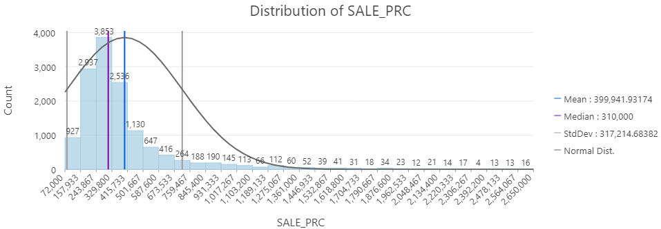
Results - ESDA - Distribution/Summary of Sale Price

Slide 14
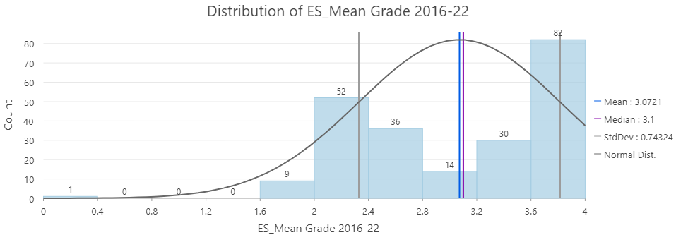
ESDA - Distribution of ES Mean Grades 2016-2020

Slide 15
Mean Center and Standard Ellipse
A weighted mean center is similar to a geographic mean center, but takes into account the different weights or values associated with each location in a group.
This means that instead of treating all locations equally, the weighted mean center gives more importance to locations that have a higher value or weight.
The mean center for this layout is weighted based on the sale price of the homes.
The weighted standard ellipse takes into account the weights or values associated with each point or feature, which allows for a more accurate representation of the spatial distribution of the data.
Essentially, the weighted standard ellipse is an ellipse that is drawn around a set of points, taking into account both the covariance and the weights or values of each point.
The size, shape, and orientation of the weighted standard ellipse are determined by the standard deviation of the weighted x and y coordinates, as well as their covariance.
The center of the ellipse represents the weighted mean location of the points, while the length and orientation of the axes of the ellipse represent the degree and direction of variation in the dataset. The standard ellipse of this map is weighted by Sale Price.

Slide 16
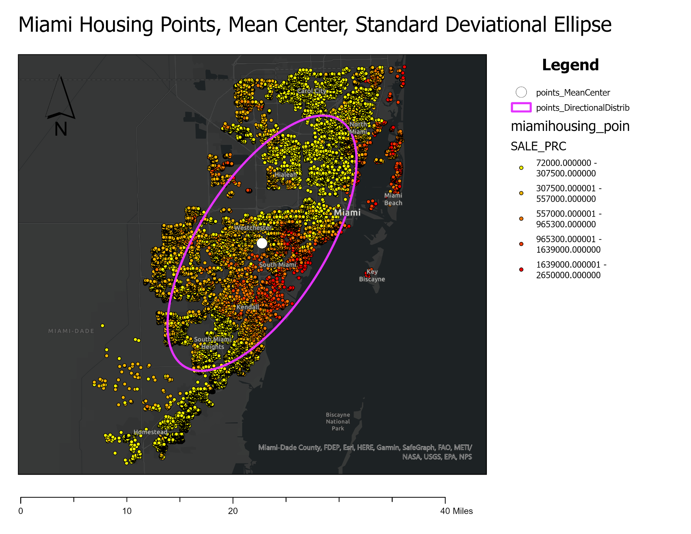

Slide 17
Interpretation
The map with the sale price points is fairly intuitive when considering the how Miami is laid out
There are many higher price homes in the Miami Beach, Coral Gables, South Miami, Pinecrest, and Palmetto Bay areas
These areas have been developed with large single-family homes that typically have many rooms and large yards, there's not much space in most of these areas to further develop
These areas have also been established for a long time compared to more recently developed areas like Cutler Bay and Homestead
They are also near US1 which is an arterial roadway, and in reasonable distance of marinas and the ocean

Slide 18
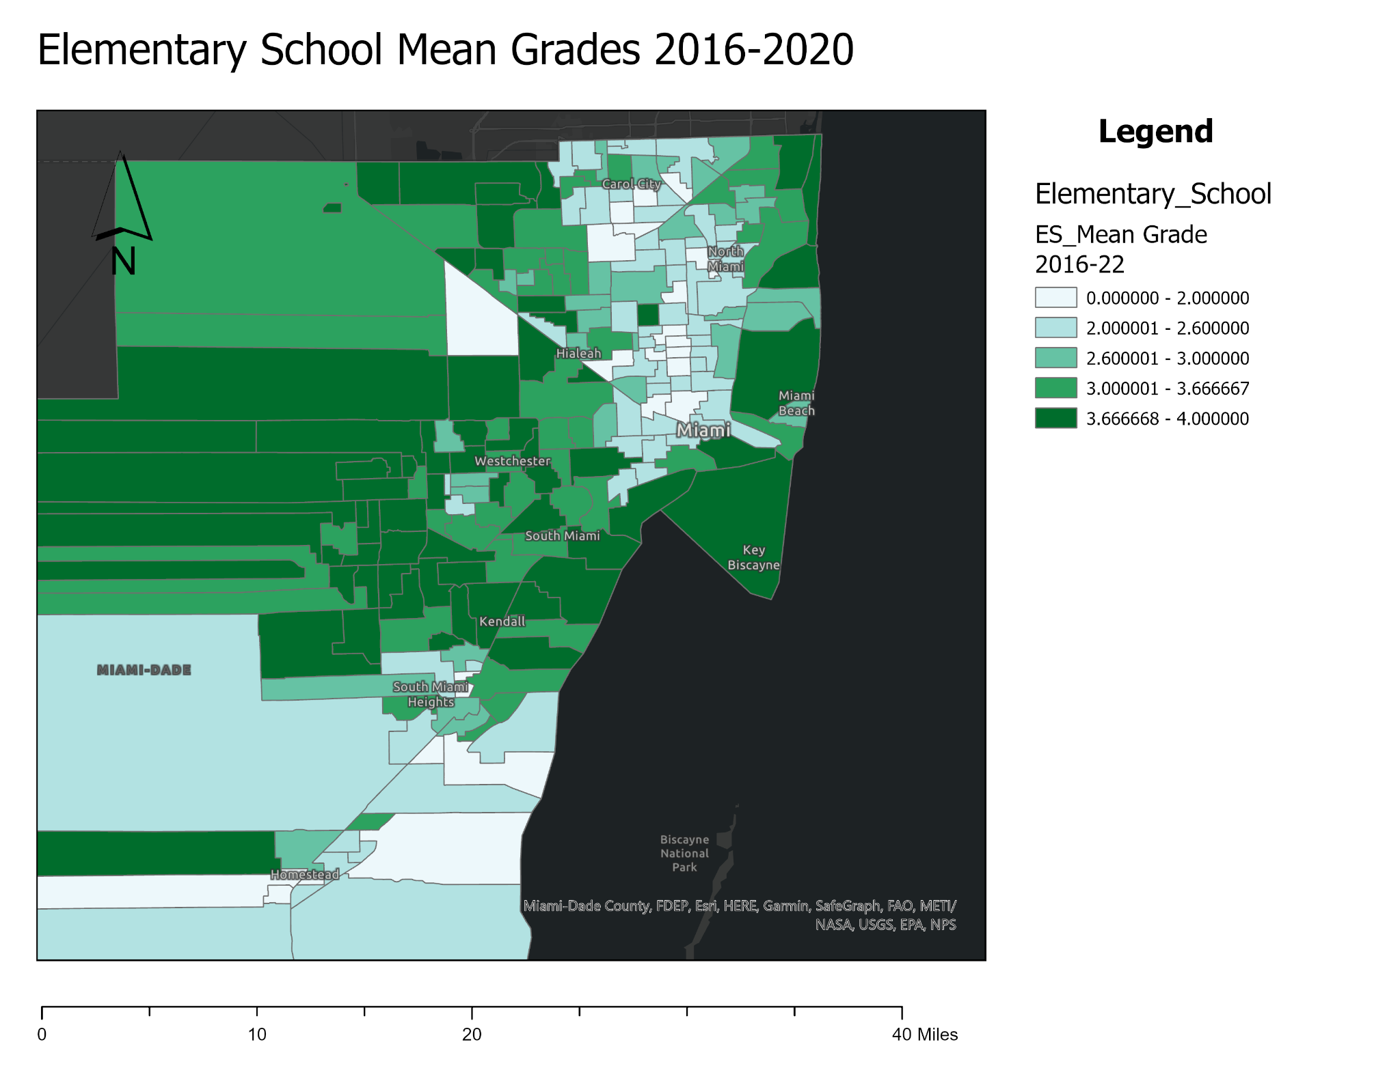

Slide 19
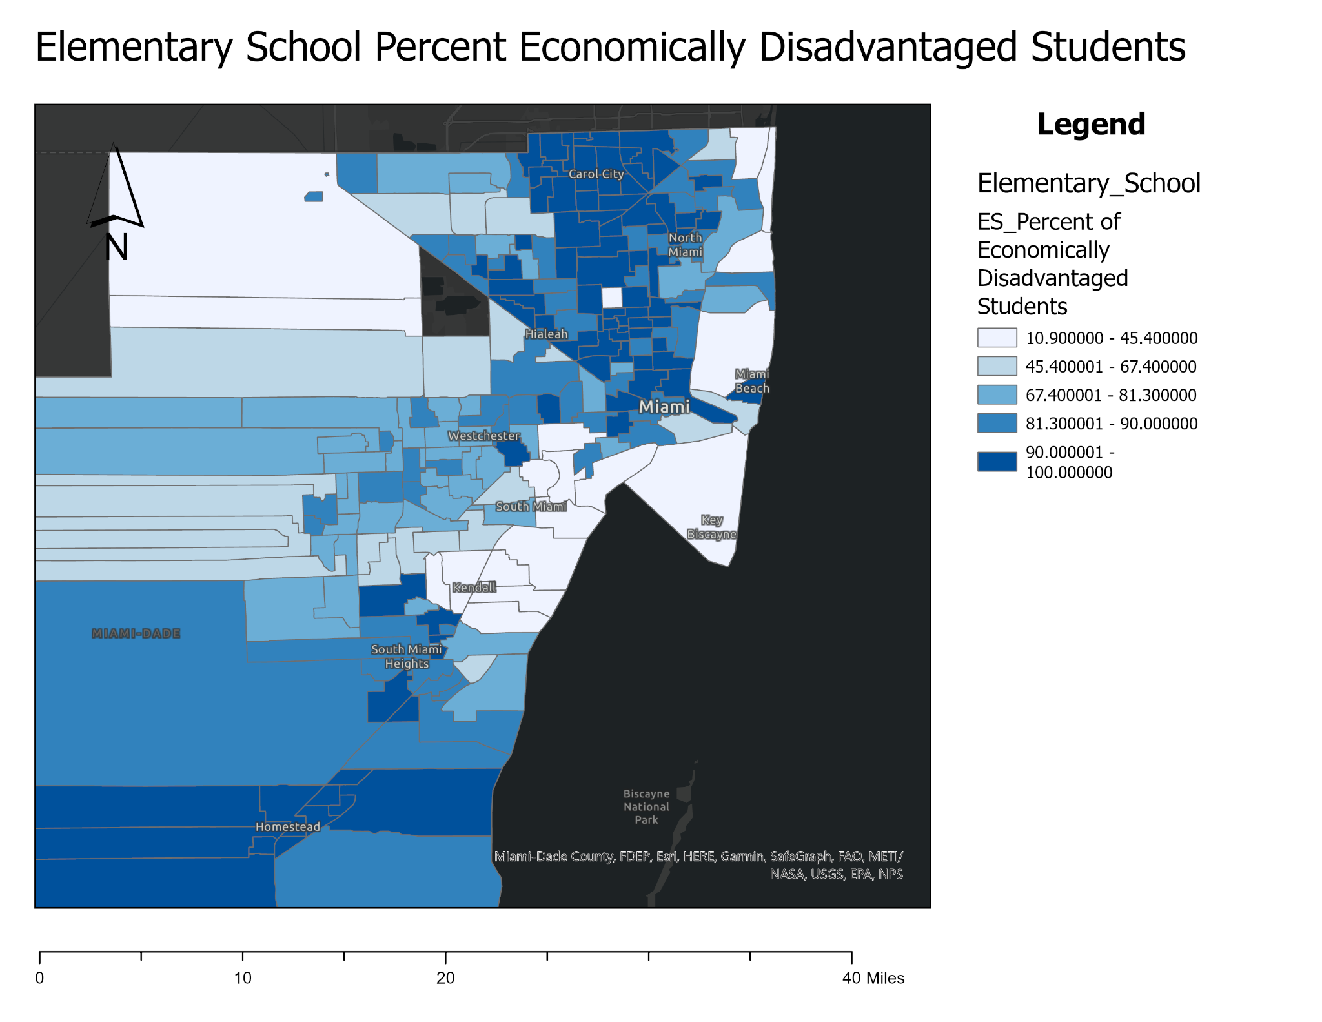

Slide 20
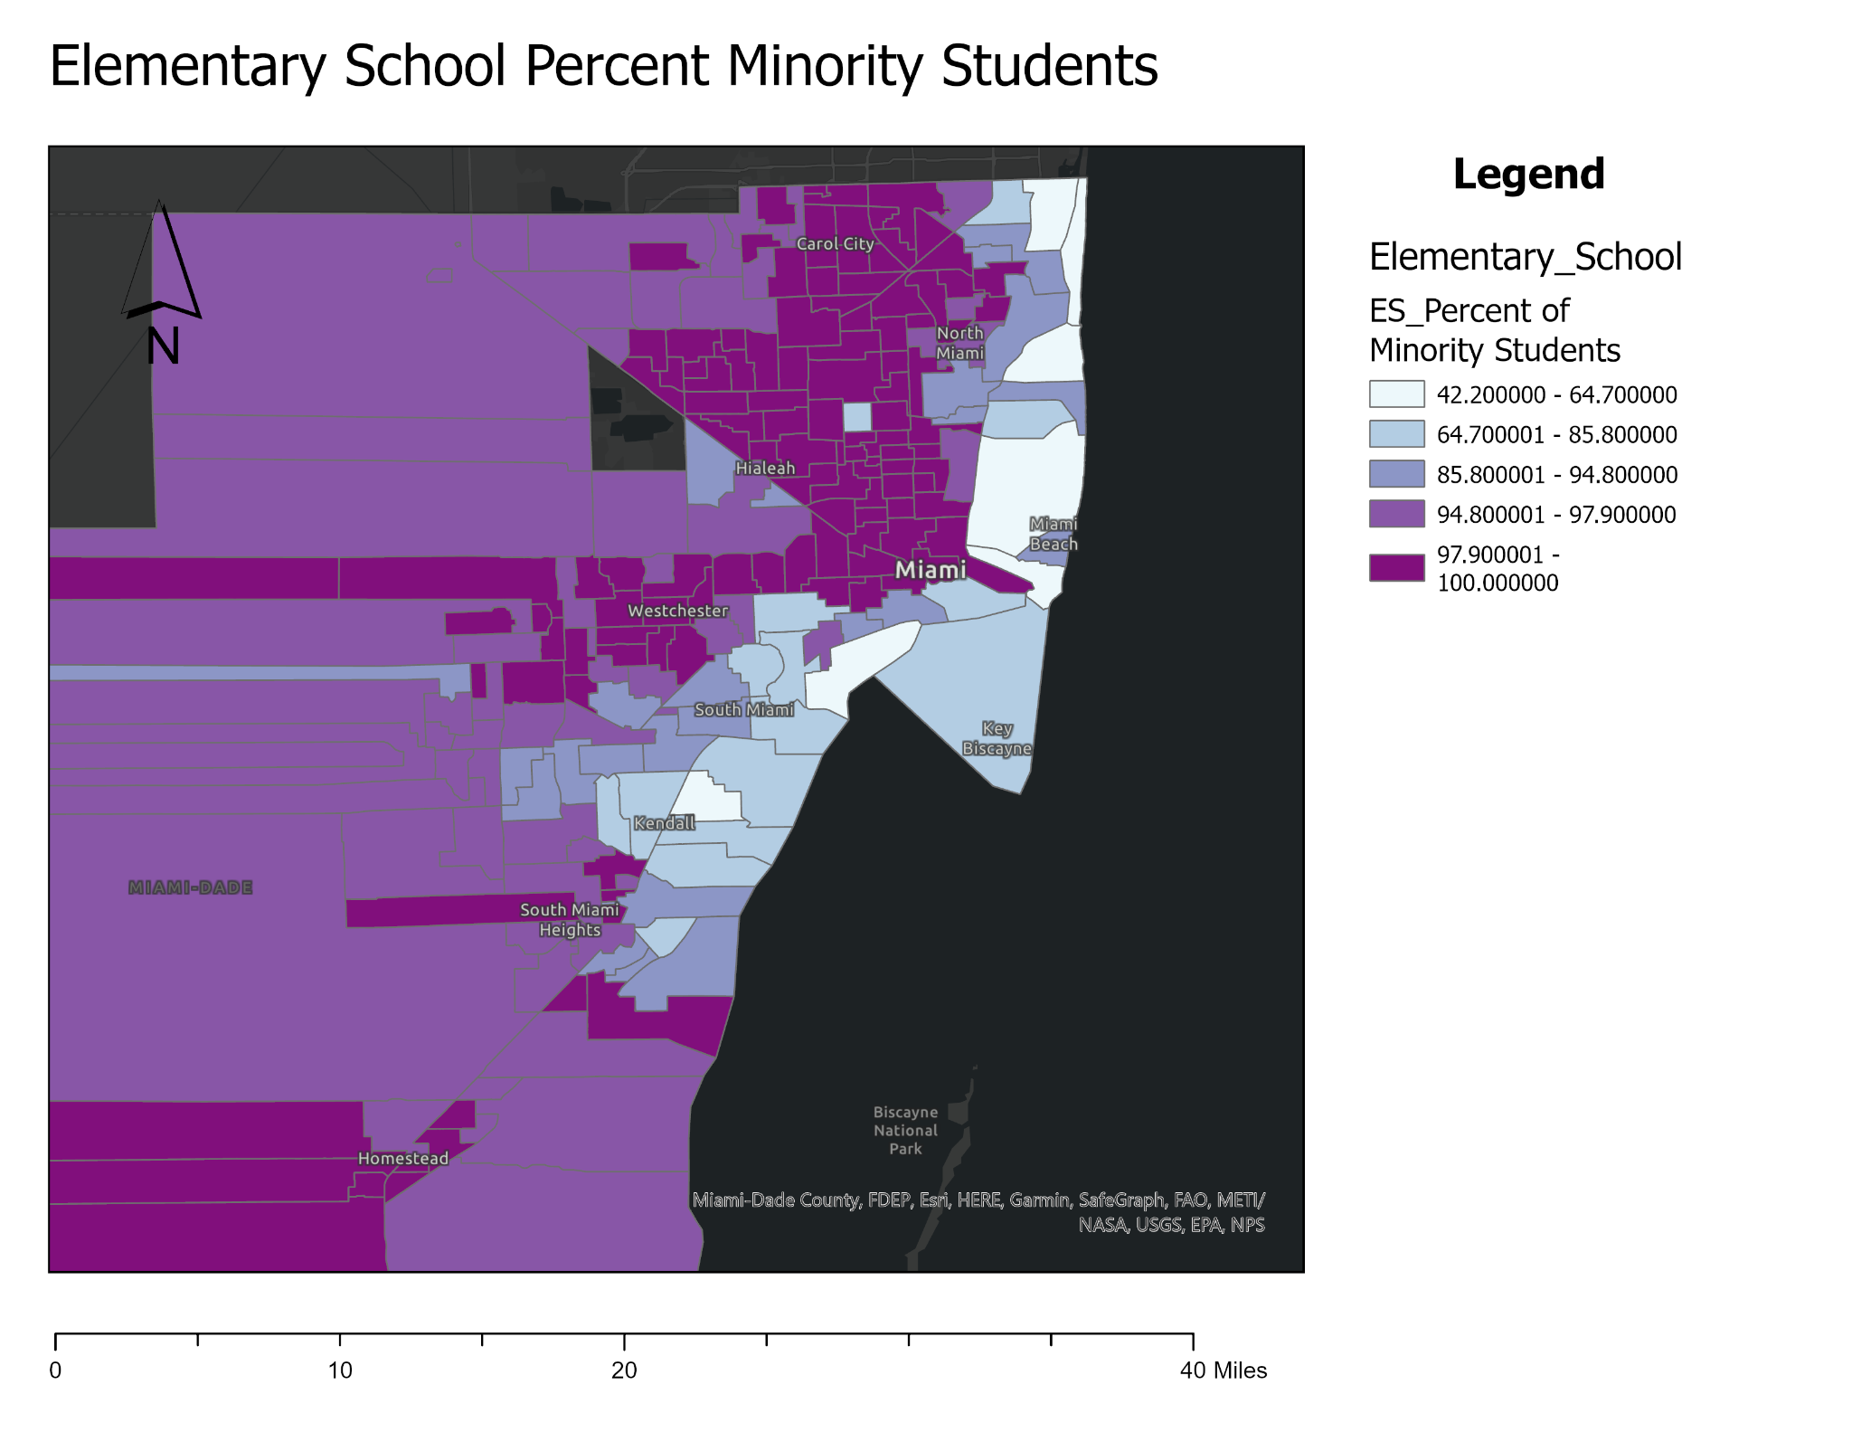

Slide 21
Local Bivariate Relationships
The Local Bivariate Relationships tool allows you to quantify the relationship between two variables on the same map by determining if the values of one variable are dependent on or are influenced by the values of another variable and if those relationships vary over geographic space.
The tool calculates an entropy statistic in each local neighborhood that quantifies the amount of shared information between the two variables.
Unlike other statistics that can often only capture linear relationships (such as linear regression), entropy can capture any structural relationships between the two variables, including exponential, quadratic, sinusoidal, and even complex relationships that cannot be represented by typical mathematical functions.

Slide 22
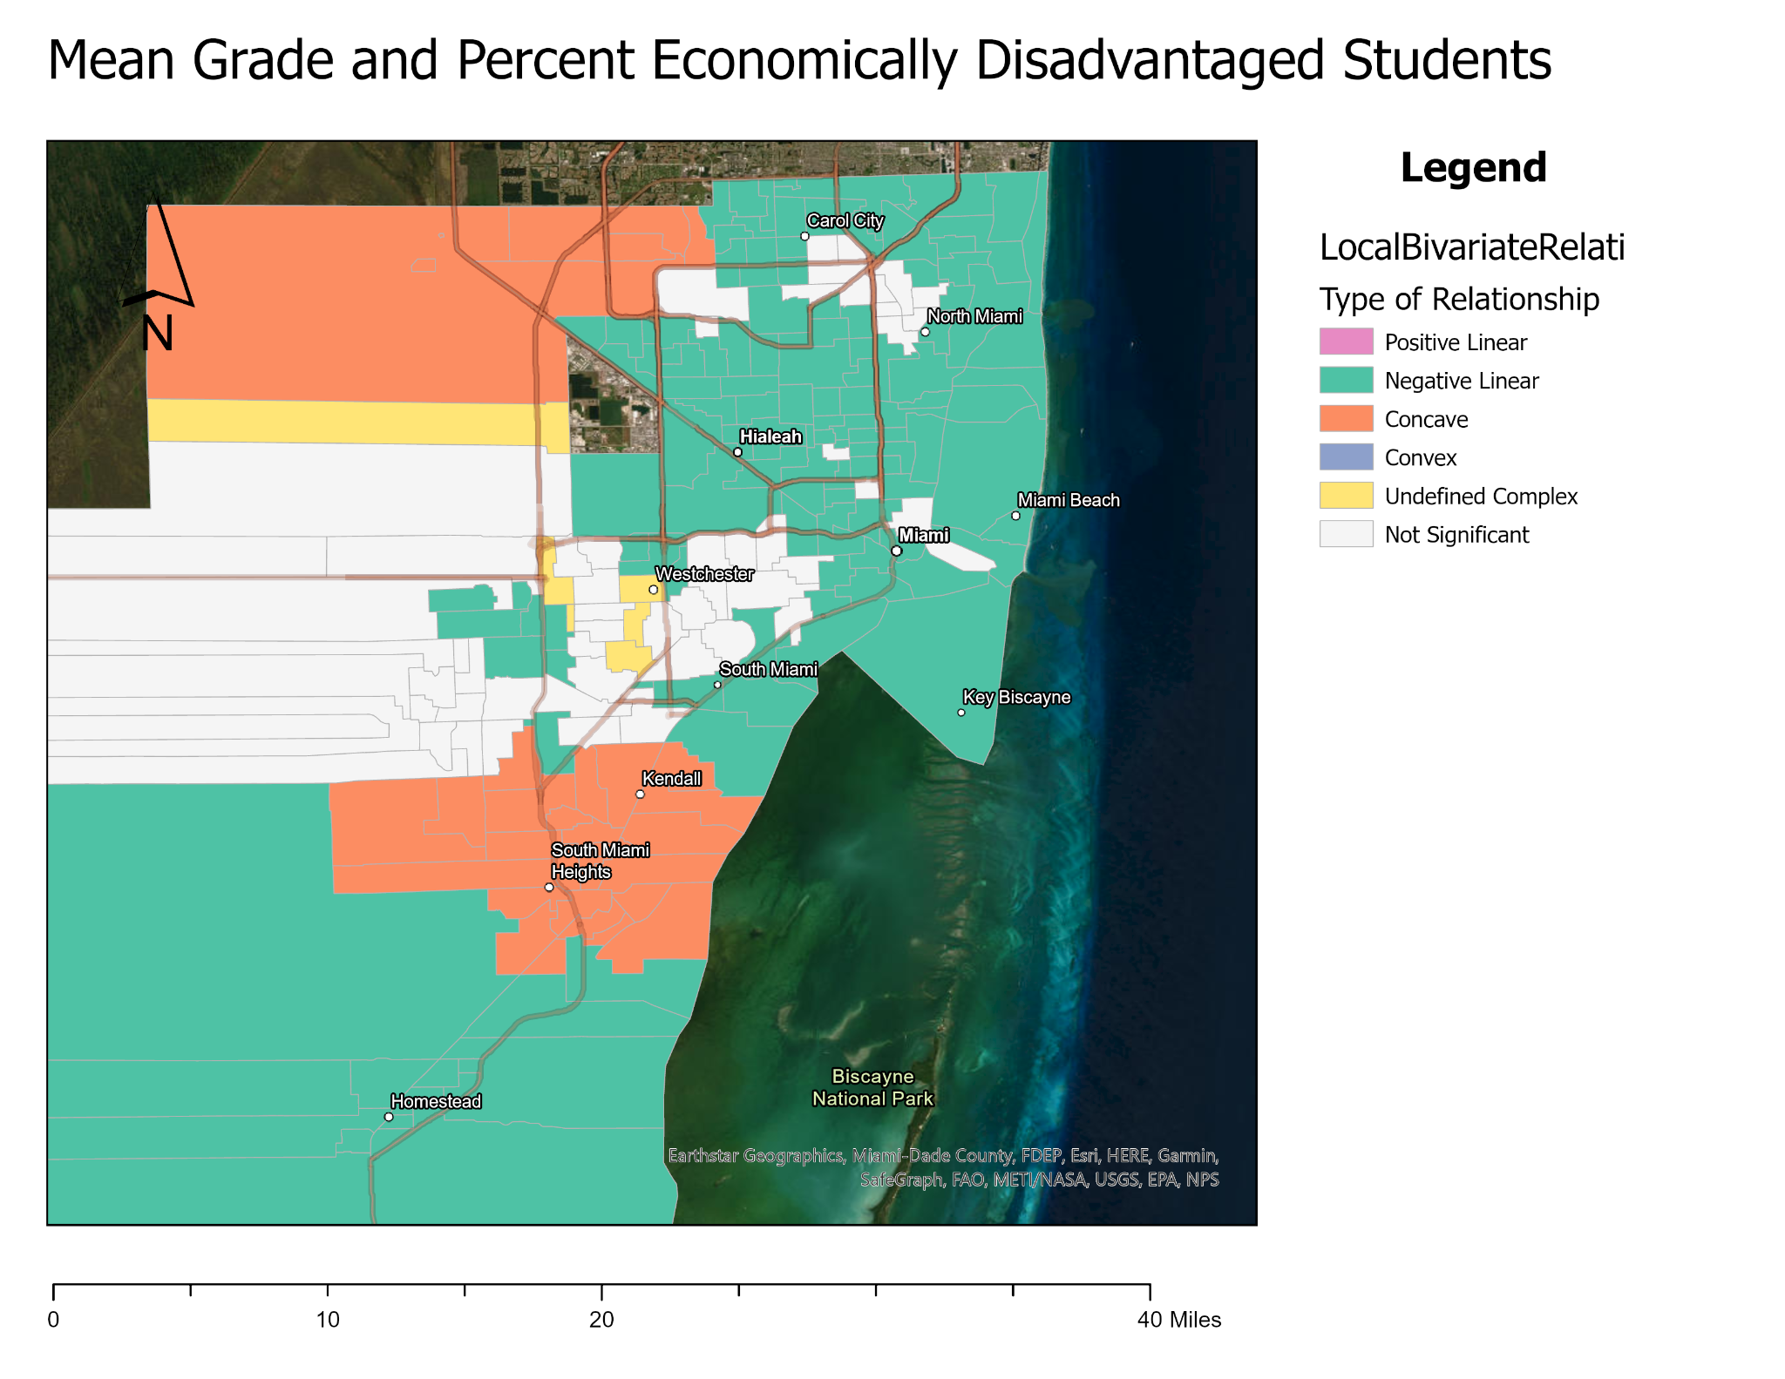

Slide 23
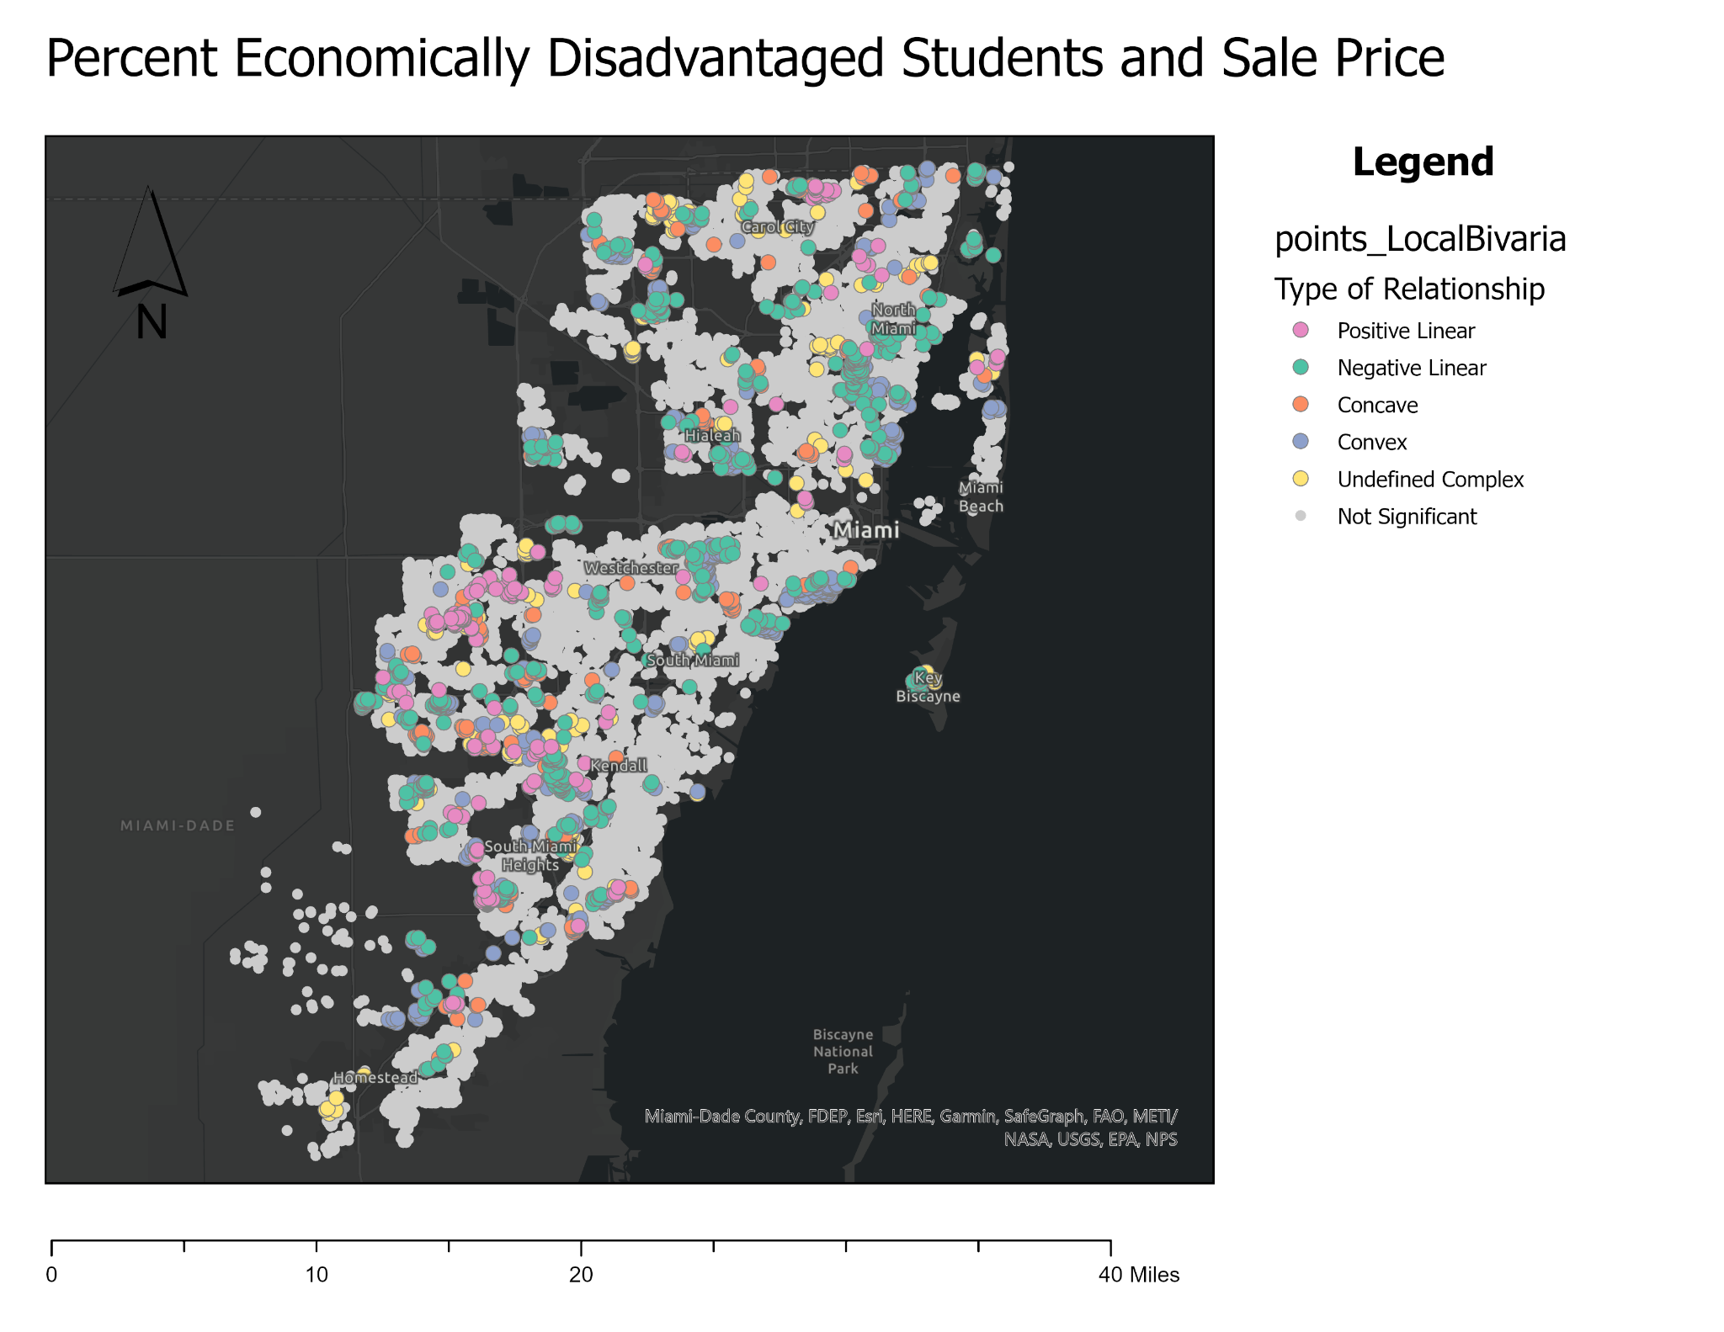

Slide 24
Interpretation
It can be seen that there is a relationship of the mean grades of elementary schools and the percentage of economically disadvantaged students attending the school
This is supported by the local bivariate correlations for these variables, indicating in most areas a negative linear correlation between mean grade and percentage of economically disadvantaged students attending
Mean grade was set as the dependent (y) variable and economically disadvantaged percentage as the explanatory (x) variable
Also seen are concave correlations which would indicate a non-linear relationship
There is also a relationship between percentage of economically disadvantaged students (y) and sale price (x)
However, this relationship is complex, and non-uniform in that it's clustered and different at each cluster

Slide 25
Hot-Spot Analysis
The Hot Spot Analysis tool calculates the Getis-Ord Gi* statistic (pronounced G-i-star) for each feature in a dataset.
The resultant z-scores and p-values tell you where features with either high or low values cluster spatially.
This tool works by looking at each feature within the context of neighboring features.
A feature with a high value is interesting but may not be a statistically significant hotspot. To be a statistically significant hotspot, a feature will have a high value and be surrounded by other features with high values as well.
The local sum for a feature and its neighbors is compared proportionally to the sum of all features; when the local sum is very different from the expected local sum, and when that difference is too large to be the result of random chance, a statistically significant z-score results.
When the FDR correction is applied, statistical significance is adjusted to account for multiple testing and spatial dependency.
The Gi* statistic returned for each feature in the dataset is a z-score. For statistically significant positive z-scores, the larger the z-score is, the more intense the clustering of high values (hot spot). For statistically significant negative z-scores, the smaller the z-score is, the more intense the clustering of low values (cold spot).

Slide 26
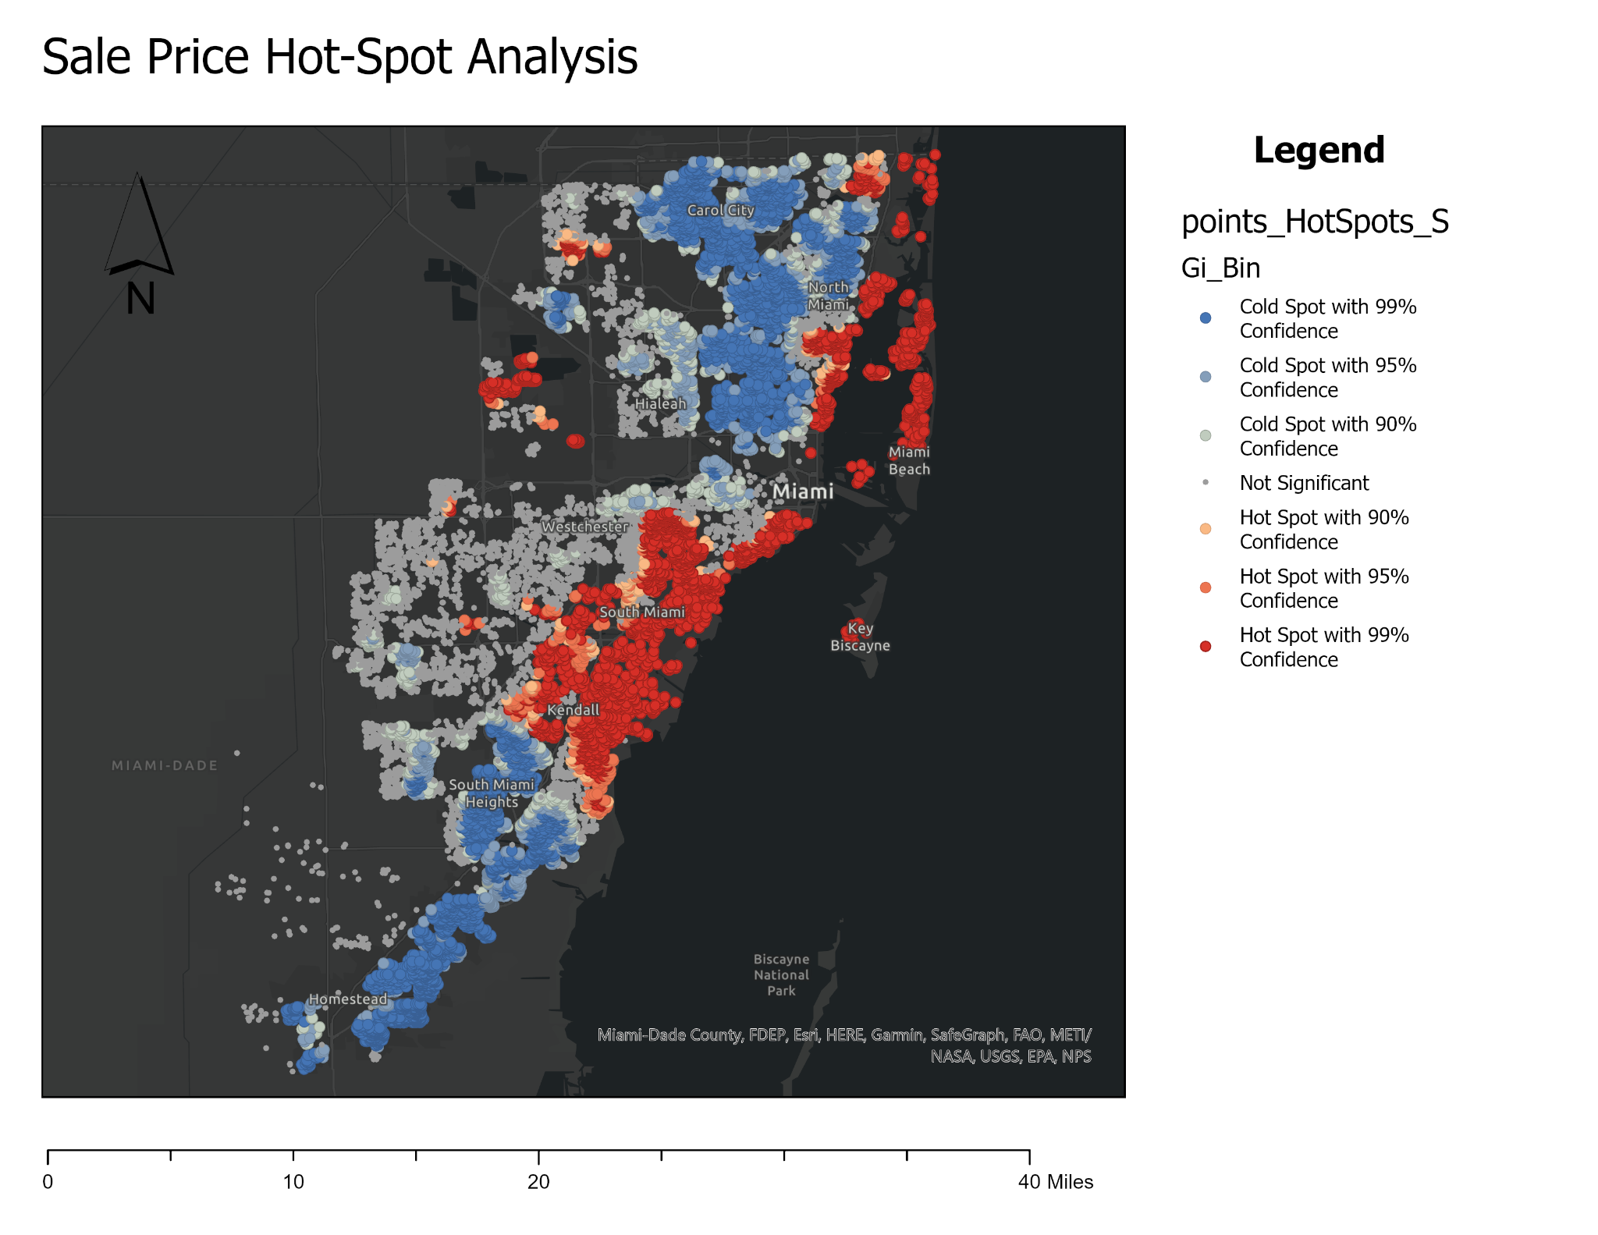

Slide 27
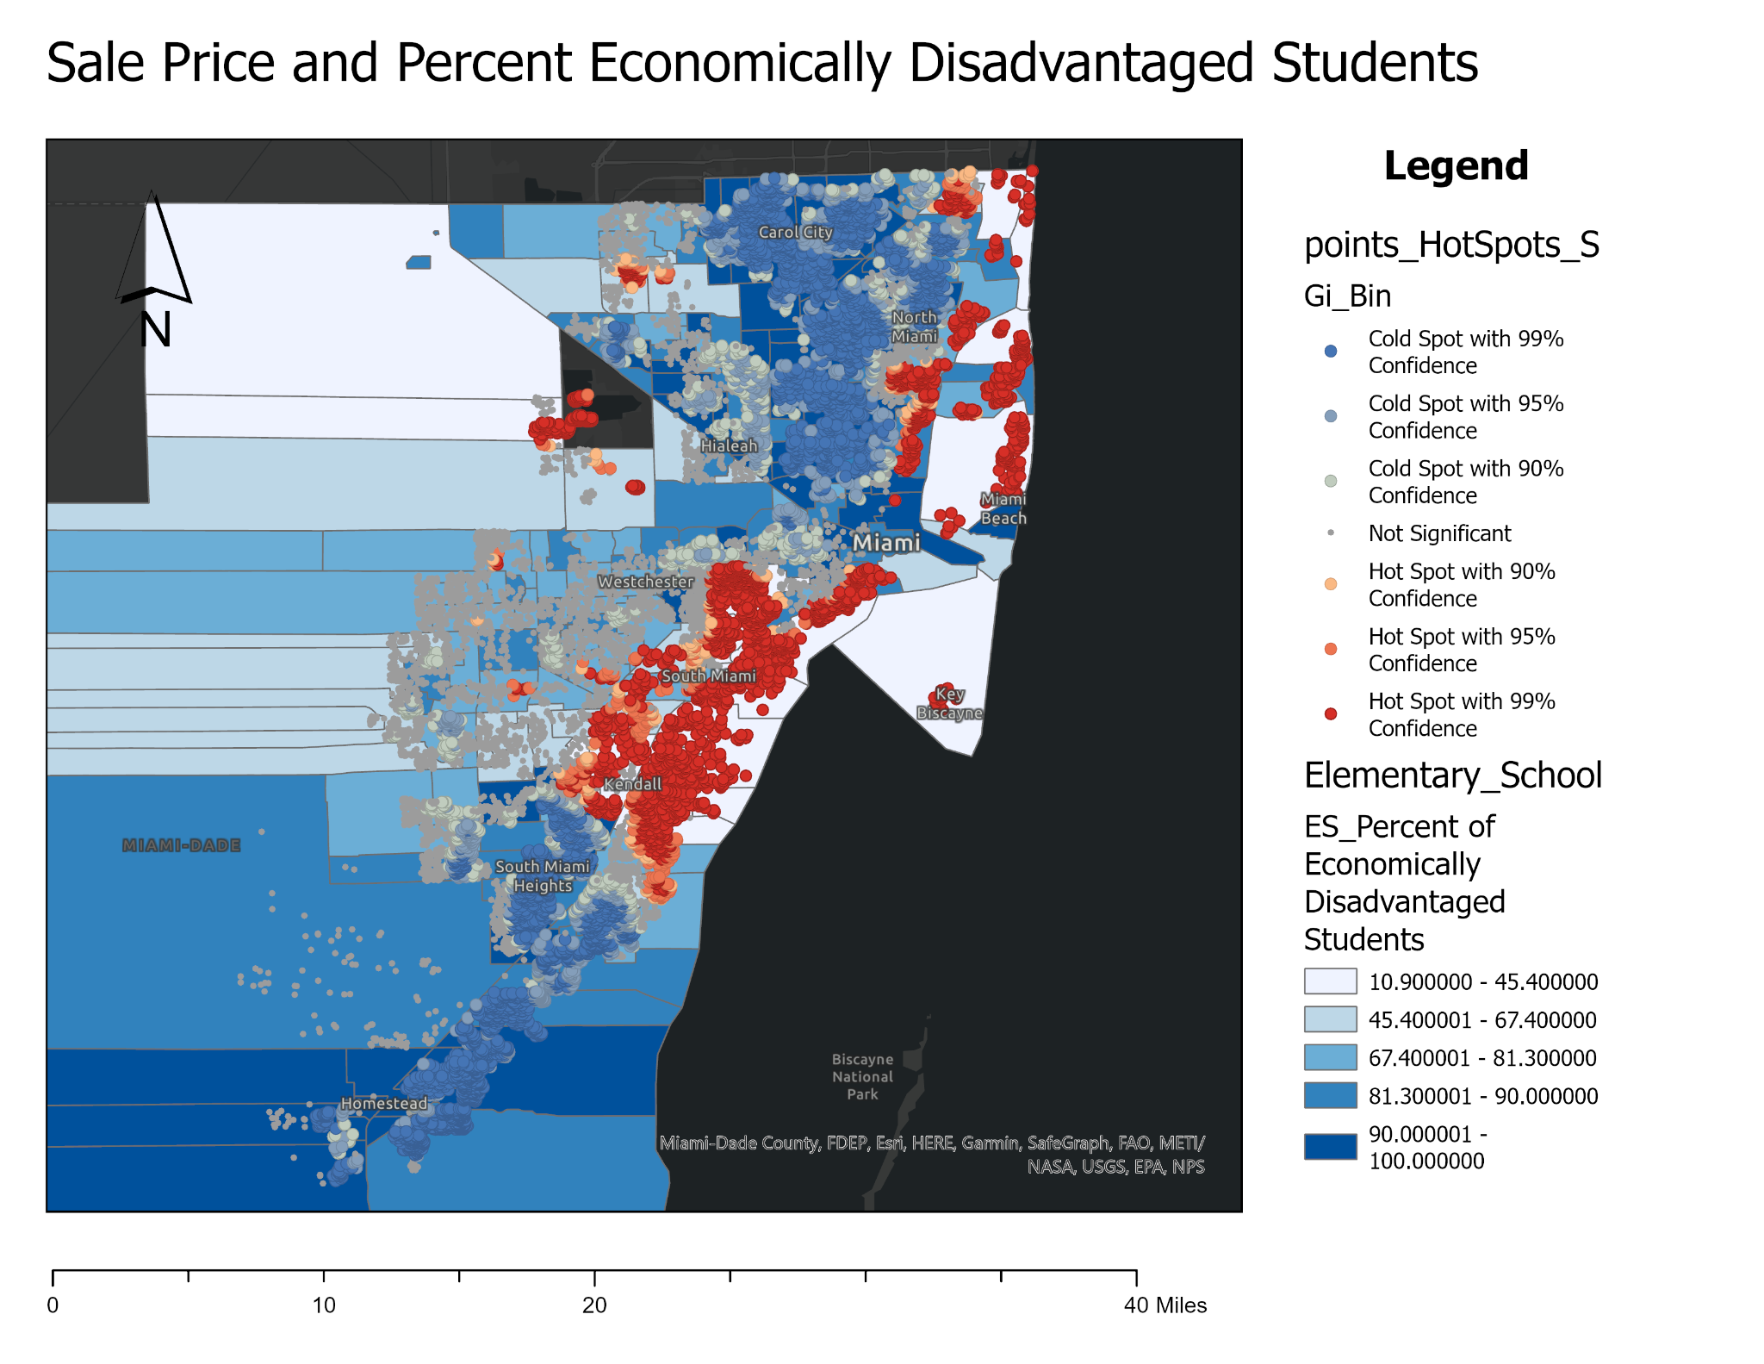

Slide 28
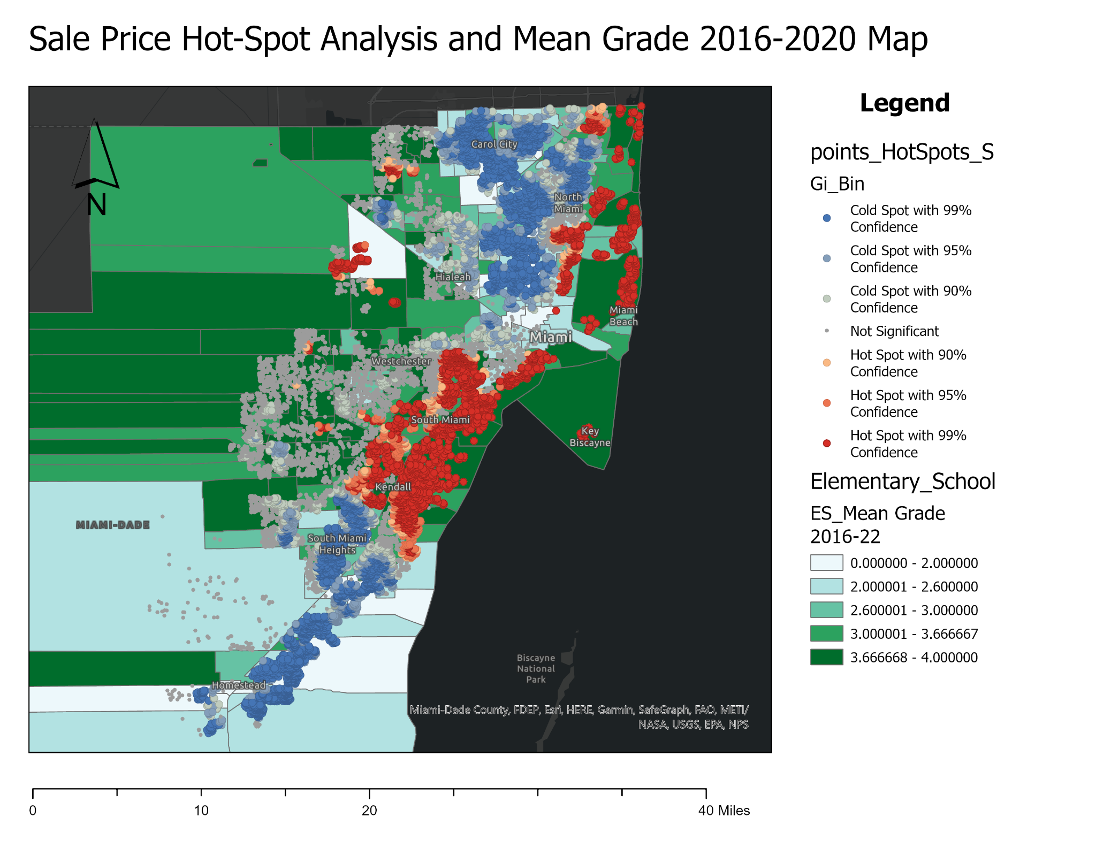

Slide 29
Interpretation
We see the same trends when looking at a hot-spot analysis of sale price that we see when mapping the sale prices
The exception are that there are some hot spots in areas where there has been recent development of homes and townhomes in the Doral and Miami Lakes area, seen in the yellow circles
There may also be a relationship between the sale price hot spots and the percentage of economically disadvantaged students
Since there is a relationship between economically disadvantaged student percentage and mean grade, it is also reasonable to see that home sale price and mean grade would both trend positively

Slide 30
Spatial Autocorrelation - Global Moran's I
Spatial autocorrelation refers to the degree to which spatially neighboring observations or locations are similar to each other in terms of their measured values or attributes.
In other words, it is a statistical concept that describes the extent to which spatial proximity between observations affects the values of a variable of interest
Moran's I is a statistic commonly used to measure spatial autocorrelation in a dataset. The statistic ranges from -1 to 1, where a value of 0 indicates no spatial autocorrelation and values closer to -1 or 1 indicate increasing levels of negative or positive spatial autocorrelation, respectively.
The Moran's I statistic is often accompanied by a z-value and a p-value, which help to assess the statistical significance of the spatial autocorrelation. The z-value measures the number of standard deviations that the observed Moran's I statistic is from the expected value under the null hypothesis of no spatial autocorrelation. The p-value indicates the probability of observing a Moran's I value as extreme or more extreme than the observed value, assuming the null hypothesis is true.
If the observed Moran's I value is positive and the z-value is greater than 0, then the data exhibits positive spatial autocorrelation, meaning that similar values tend to occur near each other in space. If the observed Moran's I value is negative and the z-value is less than 0, then the data exhibits negative spatial autocorrelation, meaning that dissimilar values tend to occur near each other in space.

Slide 31
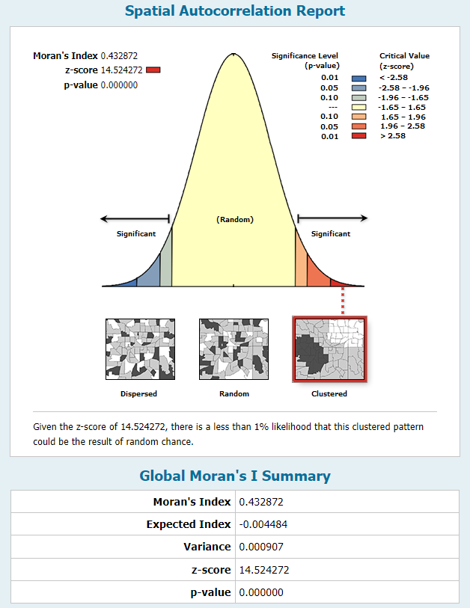
Spatial Autocorrelation - Mean Grades
There is spatial clustering of Elementary School mean grades
Moran' Index: 0.43
Z-Score: 14.52
P-value: 0.000
Using inverse distance squared and row standardization

Slide 32
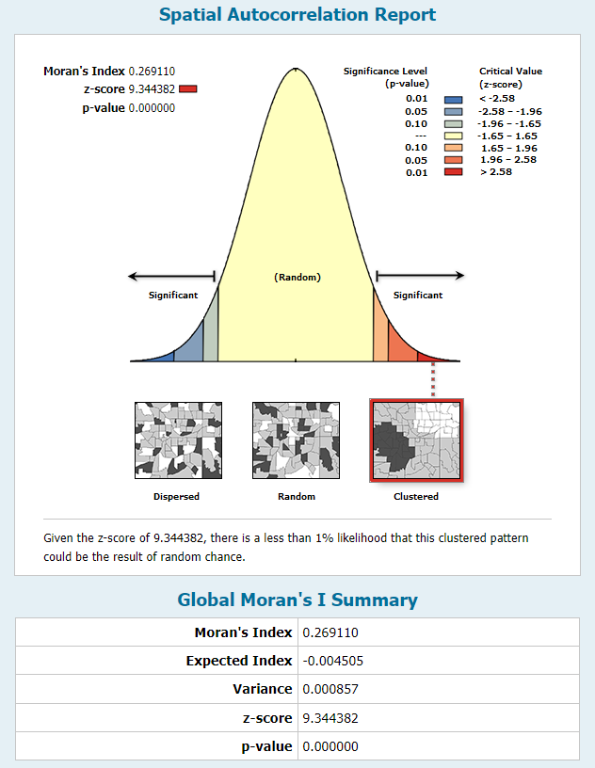
Spatial Autocorrelation - Minority Student Percent
There is spatial clustering of Elementary School minority student percentages
Moran' Index: 0.27
Z-Score: 9.34
P-value: 0.000
Using inverse distance squared and row standardization

Slide 33
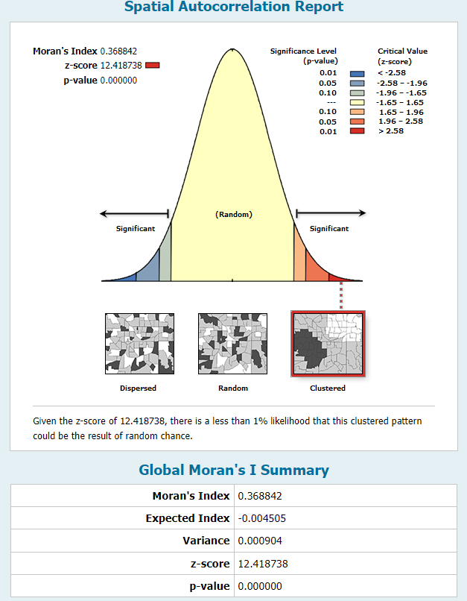
Spatial Autocorrelation - Eco. Dis. Student Percent
There is spatial clustering of Elementary School economically disadvantaged student percentages
Moran' Index: 0.37
Z-Score: 12.42
P-value: 0.000
Using inverse distance squared and row standardization

Slide 34
Cluster and Outlier Analysis (Anselin Local Moran's I)
Given a set of features (Input Feature Class) and an analysis field (Input Field), the Cluster and Outlier Analysis tool identifies spatial clusters of features with high or low values. The tool also identifies spatial outliers.
To do this, the tool calculates a local Moran's I value, a z-score, a pseudo p-value, and a code representing the cluster type for each statistically significant feature. The z-scores and pseudo p-values represent the statistical significance of the computed index values.
A positive value for I indicates that a feature has neighboring features with similarly high or low attribute values; this feature is part of a cluster. A negative value for I indicates that a feature has neighboring features with dissimilar values; this feature is an outlier. In either instance, the p-value for the feature must be small enough for the cluster or outlier to be considered statistically significant.
The cluster/outlier type (COType) field distinguishes between a statistically significant cluster of high values (HH), cluster of low values (LL), outlier in which a high value is surrounded primarily by low values (HL), and outlier in which a low value is surrounded primarily by high values (LH). Statistical significance is set at the 95 percent confidence level.

Slide 35
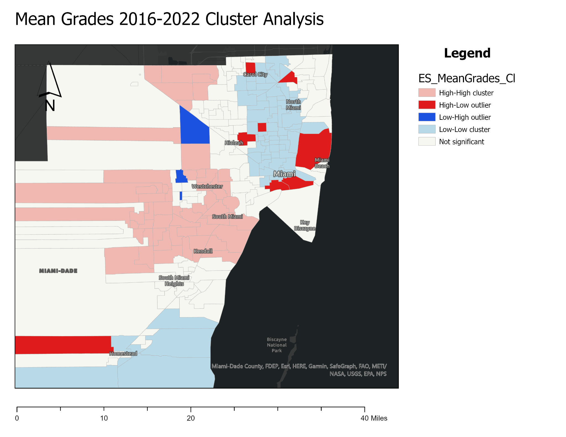

Slide 36
Interpretation
Mean Grades
High-High
We see clusters of high mean grades in the Doral, South Miami, Kendall, West Kendall, Pinecrest, and Palmetto Bay areas
Low-Low
We see clusters of low grades in the Norland, Carol City, Miami Gardens, Opa-Locka, North Miami, Overtown, Allapattah and Wynwood areas
Low-High Outlier
The low-high outlier in Hialeah Gardens (circled green) is missing data, the mean grade value is 0
The other low-high outliers in Sweetwater (not circled) have mean grade values that are significantly lower than the surrounding schools
High-Low Outliers
There are high-low outliers surrounding the low-low cluster in the middle of the downtown Miami area
The 2 outlier areas at the bottom of the low cluster are located in areas where there are high sale prices, Miami Beach and Coconut Grove (circled in yellow)
The outlier area in the middle of the low cluster (not circled) has a low percentage of economically disadvantaged students and a low percentage of minority students
The other outliers (circled in purple) have other factors outside of this dataset that contribute to their high mean grades, and might be a good place to observe for policy and teaching methods because they have high mean grades and both high minority (>95%) and economically disadvantaged student percentages (>85%)

Slide 37
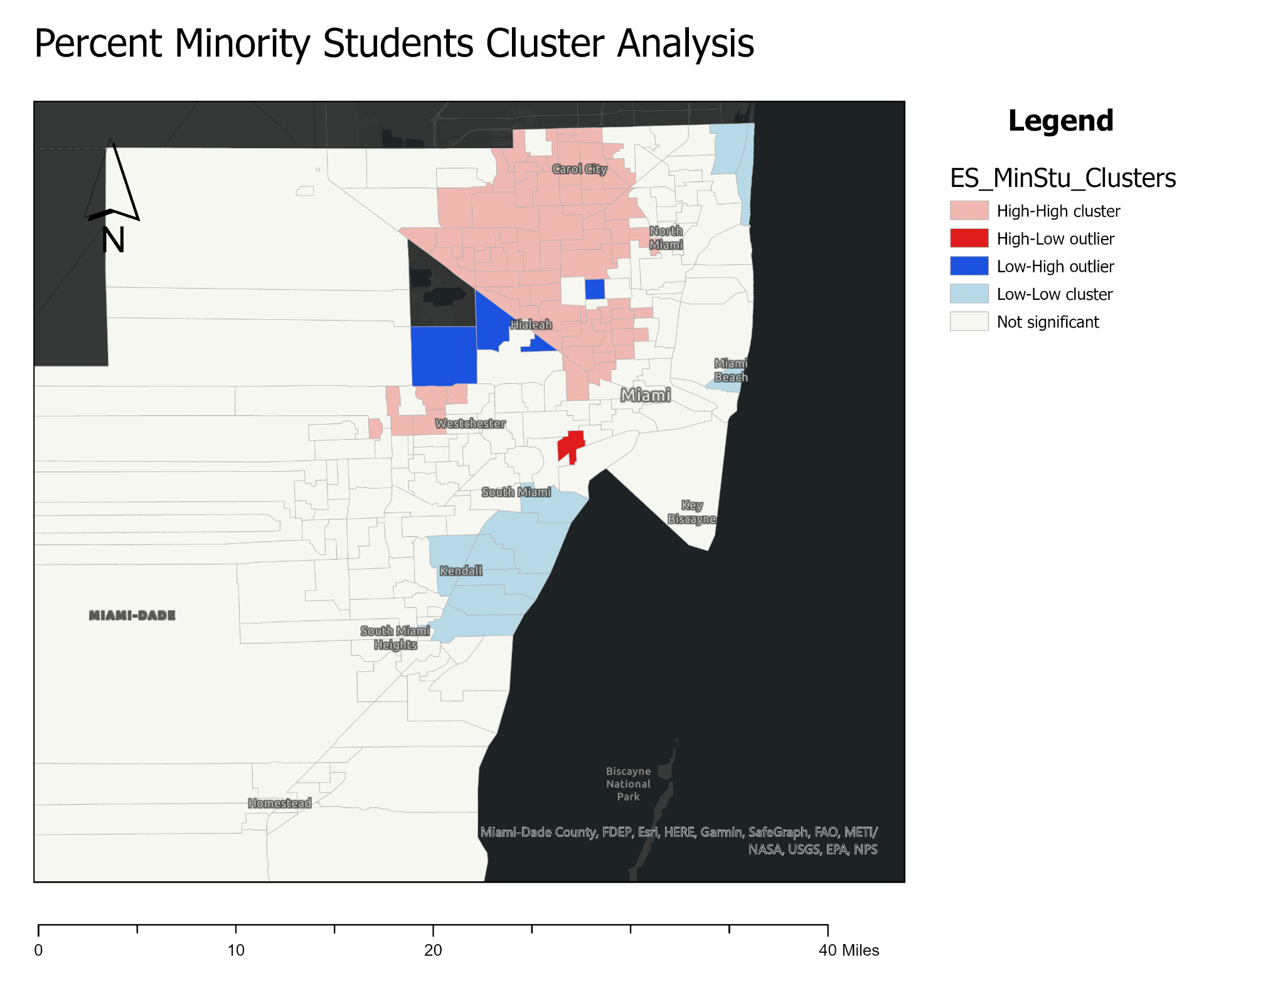

Slide 38
Interpretation
Minority Student Percentage
High-High
We see clusters of high minority student percentages in the Sweetwater, Hialeah, Miami Gardens, Miami Lakes, Opa-Locka and Carol City areas
Low-Low
We see clusters of low minority student percentages in the Sunny Isles Beach, Miami Beach, Pinecrest, and Palmetto Bay areas
Low-High Outlier
There are surprisingly low-high outliers in the Hialeah and Doral areas, but upon closer examination the actual minority percentages are >92%, so practically this is unimportant
There is a low-high outlier in the middle of a high-high cluster, that was explained with the previous interpretation (circled in yellow)
High-Low Outliers
The high-low outlier in the Coconut Grove area is surrounded by areas with higher priced homes and is actually facing issues of gentrification

Slide 39
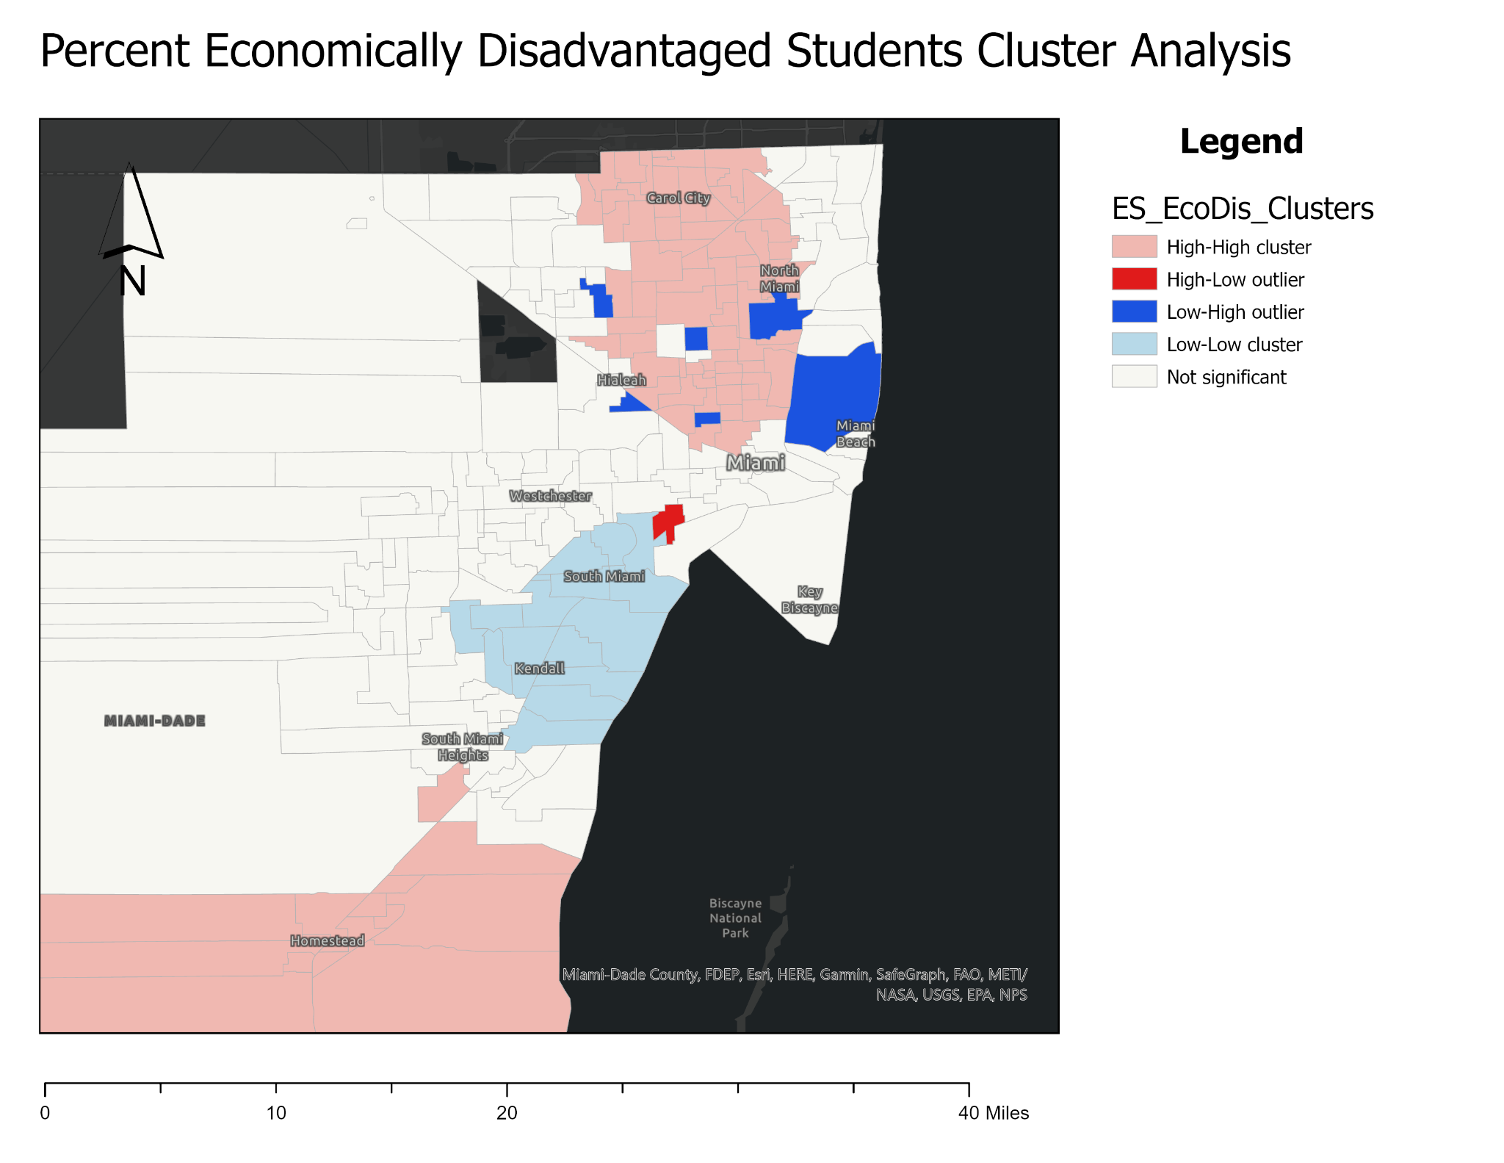

Slide 40
Interpretation
Economically Disadvantaged (ED) Student Percentage
High-High
We see clusters of high ED student percentages in the Homestead, Florida City and Goulds (south) areas, as well as the Hialeah, Allapattah, Opa-Locka, North Miami, and Miami Gardens areas
Low-Low
We see clusters of low ED student percentages in the South Miami, Pinecrest, and Palmetto Bay areas
Low-High Outlier
There are low-high areas
There is a low-high outlier in the middle of a high-high cluster, that was explained with the previous interpretation (circled in yellow)
High-Low Outliers
The high-low outlier in the Coconut Grove area is surrounded by areas with higher priced homes and is actually facing issues of gentrification

Slide 41
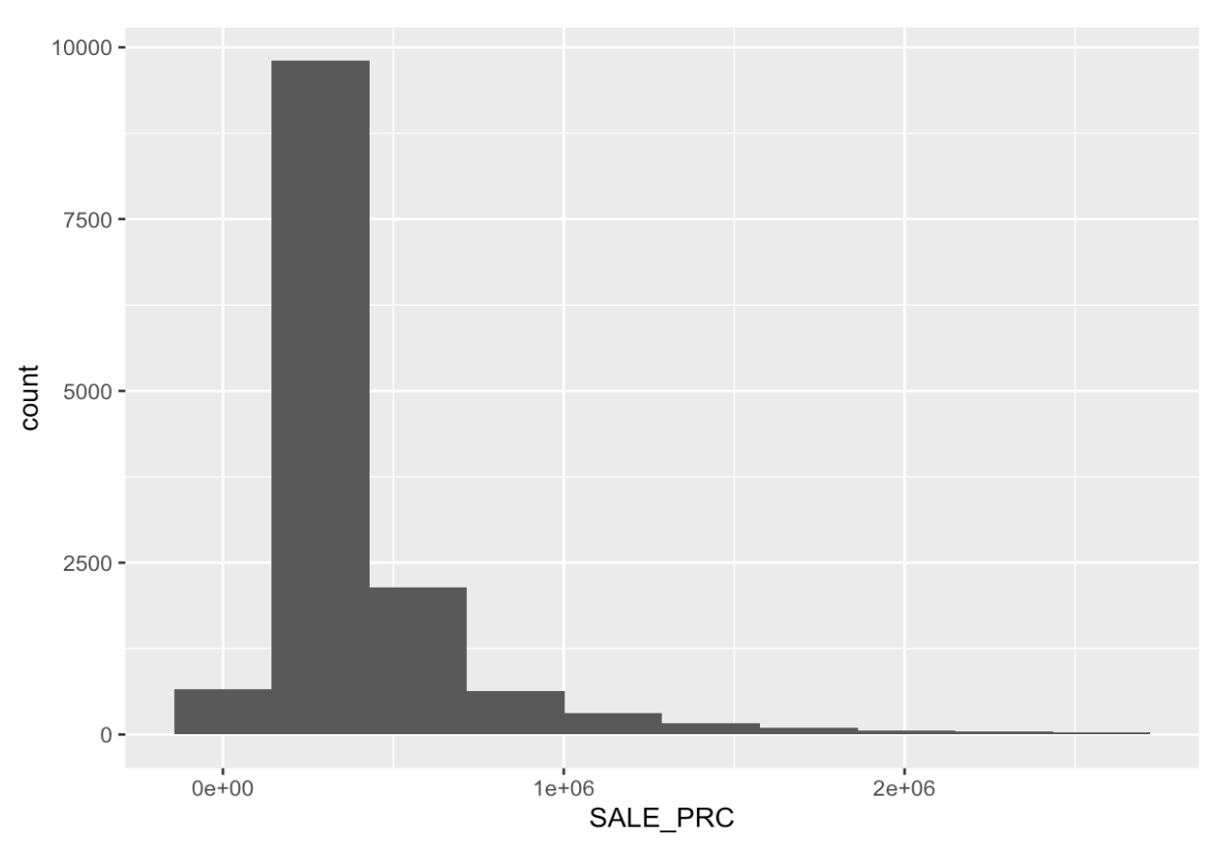
Analyses Outside of ArcGIS - EDA
A histogram of sale price with 10 bins shows the imbalance of frequency for homes with lower sale prices (positive skew)

Slide 42
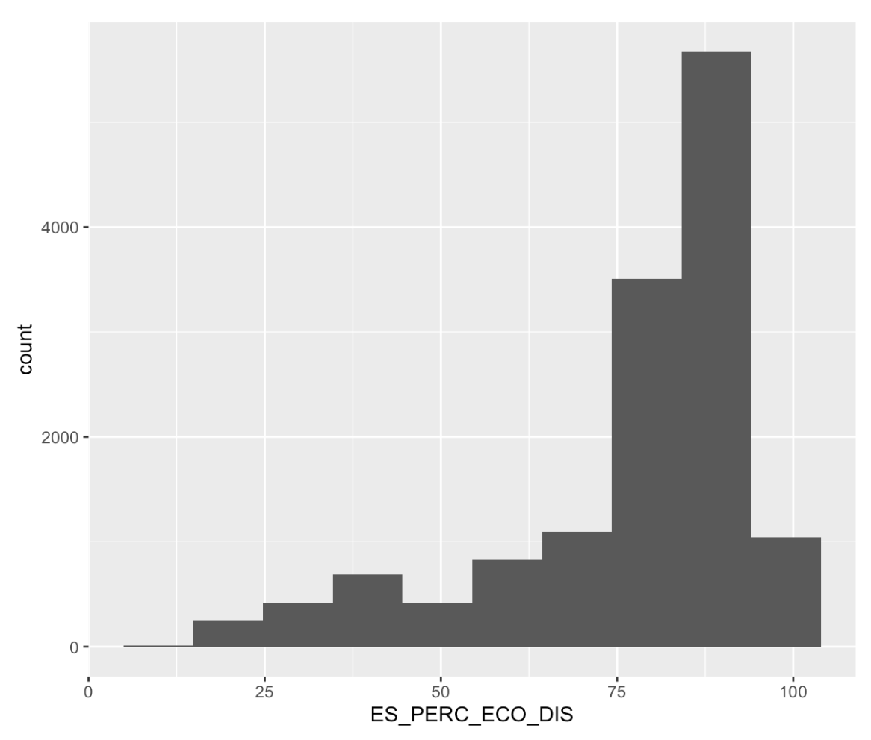
Exploratory Data Analysis
A histogram of the percentage of elementary students that are economically disadvantaged with 10 bins shows the imbalance of frequency for high percentages of economically disadvantaged students (negative skew)

Slide 43
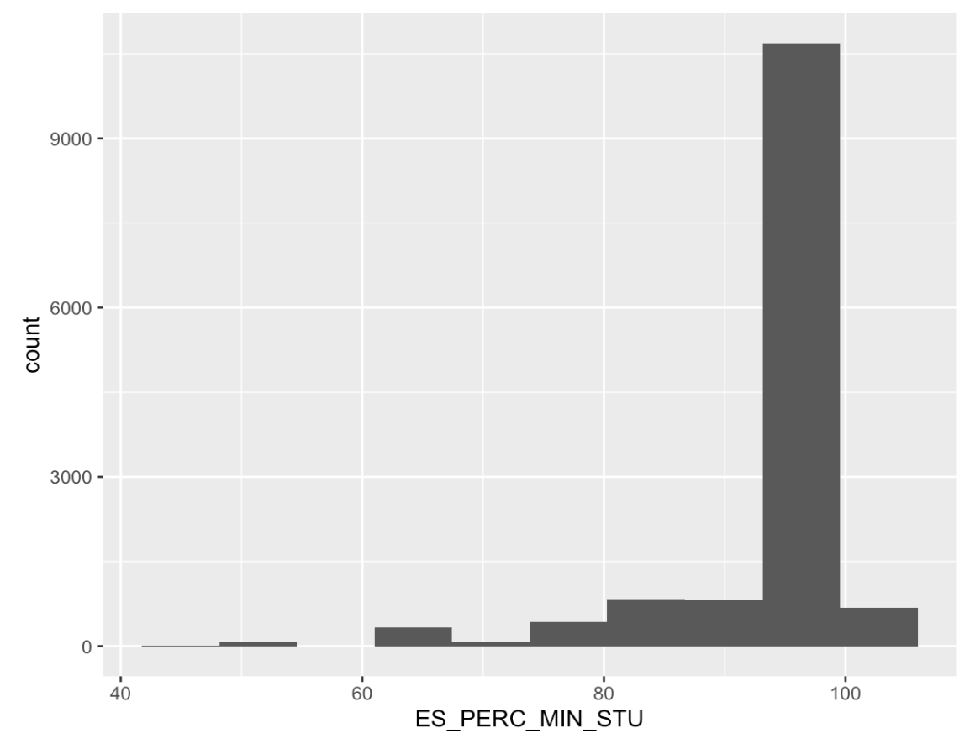
Exploratory Data Analysis
A histogram of the percentage of elementary students that are minorities with 10 bins shows the overwhelming majority of elementary students are minorities at Miami elementary schools

Slide 44
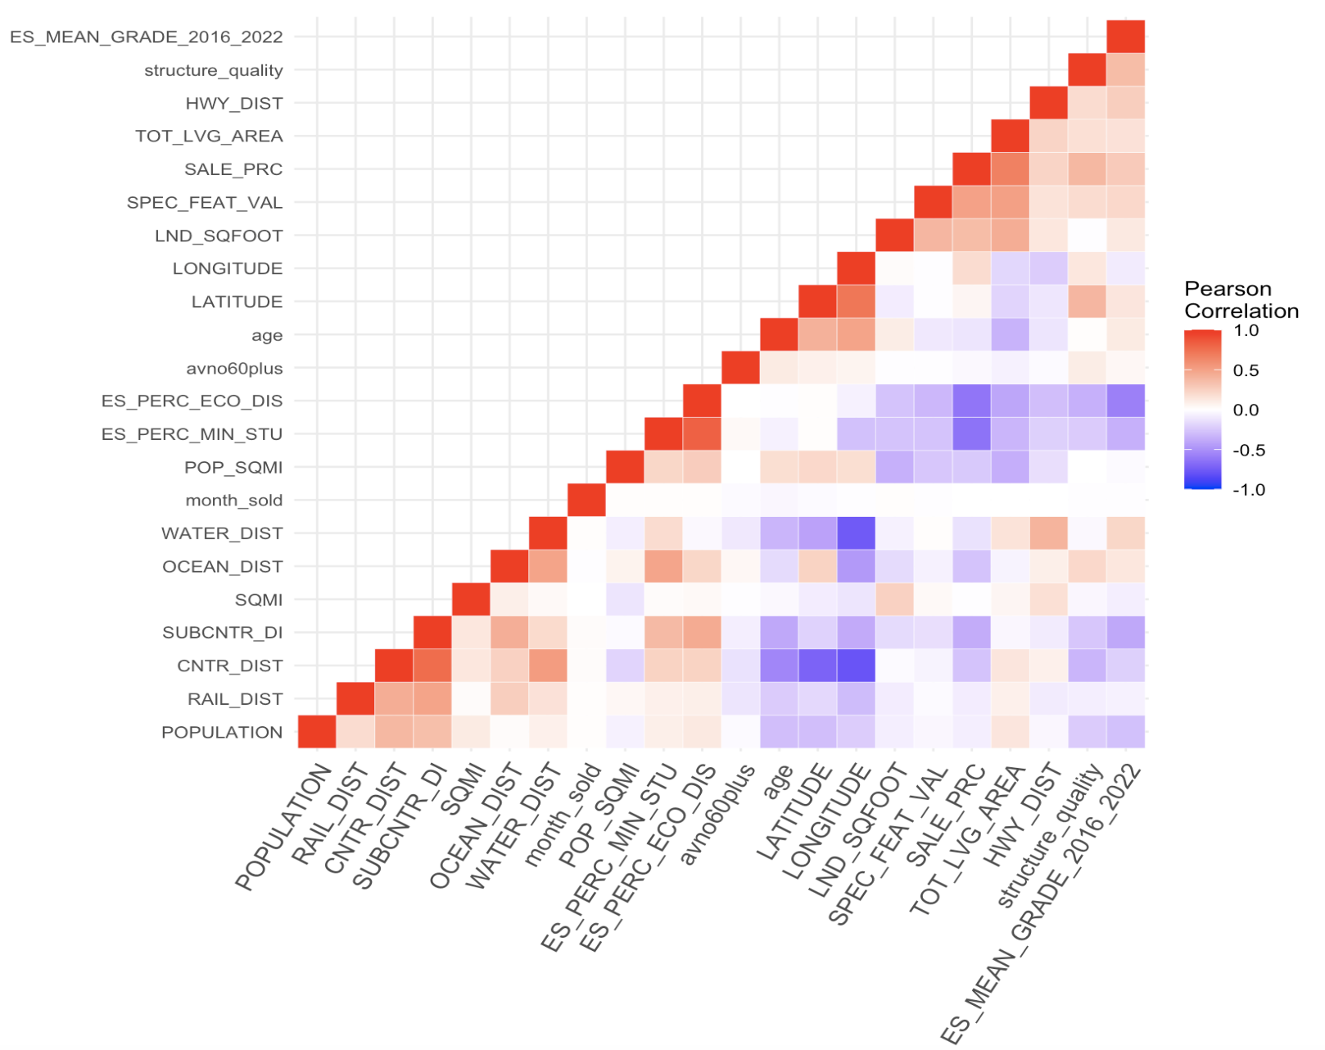

Slide 45
Correlation Heatmap
Negative Correlations
Notable negative correlations include Sale Price and the percentage of minority students (-0.64) and the percentage of economically disadvantaged students (-0.63)
It makes sense that economically disadvantaged students would not live in homes that have high selling prices
Elementary mean school grades have a negative correlation with percentage of economically disadvantaged students (-0.58) and with subcenter distance (-0.39)
Positive Correlations
Notable positive correlations include distance to the ocean and percentage of minority students (0.48)
Percentage of minority students and of economically disadvantaged students have a high correlation (0.82)
Percentage of economically disadvantaged students and distance to the nearest subcenter (metrorail, people mover, etc.) have a correlation of (0.45)
Sale Price and Mean Grade have a correlation of (0.28)
Mean Grade and distance to the nearest highway have a correlation of (0.26), and mean grade and distance to the nearest body of water have a correlation of (0.22)

Slide 46
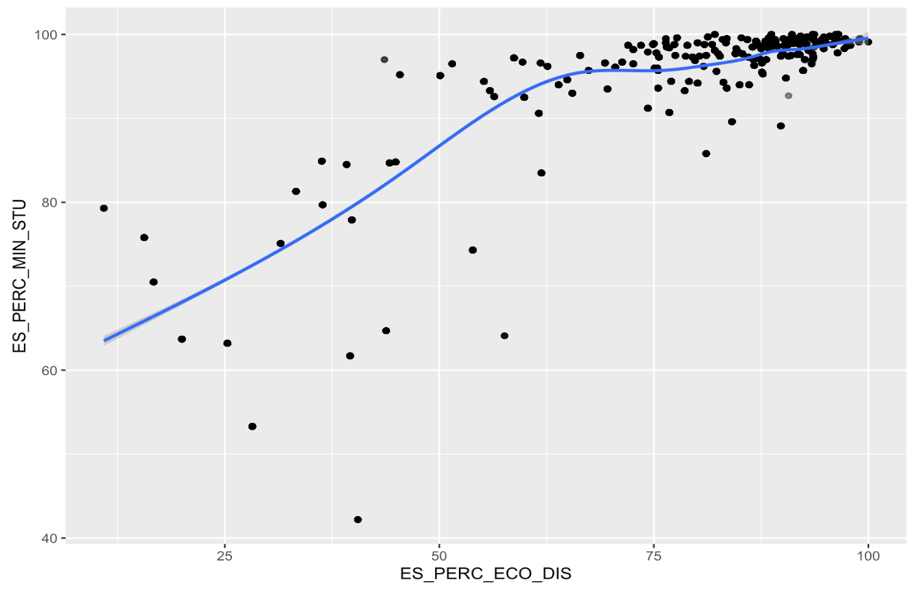

Slide 47
Scatterplot
Plotting percentage of economically disadvantaged and minority students and adding a smoothing spline based on Generalized Additive Models (GAMs) it can be seen that there is a strong linear relationship between those two variables
GAMs
A generalized additive model is a type of statistical model that allows you to analyze relationships between a response variable (the variable you're trying to predict) and one or more predictor variables (the variables you're using to make predictions) that may not have a linear relationship with the response variable.
Smoothing Spline
A smoothing spline is a type of statistical tool used to smooth out noisy data, by creating a smooth curve that represents the underlying trend in the data. Essentially, a smoothing spline is a way to fit a curve to data points, in order to extract the general trend or pattern that the data follows.

Slide 48
Evaluation - Analyses Outside of ArcGIS
The data was normalized to reduce the imbalance and make it normally distributed using standardization on all variables, this helped to improve the accuracy of the models
The data was divided into training and validation sets at an 80/20 split.
K=10 k-fold cross validation was applied for each method.
Each model was evaluated by its R² to understand how much of the variance in the model can be explained by the predictors.
LASSO
The best lambda was selected for tuning the LASSO model before predicting it on the validation set.
Cross-validation is included in the LASSO code by default
Random Forest
Optimal mtry (the number of predictors at each node) was determined by dividing the total number of predictors by 3 for regression and 10-fold cross validation was performed
Boosting
10-fold cross validation was performed
Bagging
Mtry is set to the total number of predictors, and 10-fold cross validation was performed

Slide 49
Multiple Linear Regression
Multiple linear regression is a statistical method used to model the relationship between a dependent variable (the variable you're trying to predict) and multiple independent variables (the variables you're using to make predictions).
The goal of multiple linear regression is to find the best-fit linear equation that describes how the independent variables are related to the dependent variable.
In other words, multiple linear regression allows you to predict the value of the dependent variable based on the values of several independent variables.
For example, you might use multiple linear regression to predict someone's salary based on their education level, years of experience, and age.

Slide 50
Least Absolute Shrinkage and Selection Operator (LASSO)
The lasso technique is a statistical method used to select the most important features (or variables) in a dataset, while simultaneously shrinking the coefficients of the less important features to zero.
This helps to reduce the complexity of a model and improve its predictive accuracy.
The lasso achieves this by introducing a penalty term to the regression equation that is proportional to the absolute value of the coefficients of the features.
This penalty term encourages the model to select only the most important features and to shrink the coefficients of the less important features to zero.
The lasso technique is particularly useful when working with high-dimensional datasets with many features.

Slide 51
Random Forest Regression
The random forest regression technique is a popular machine learning algorithm used for regression problems, which involve predicting a continuous value based on input variables.
The random forest algorithm creates a large number of decision trees, each trained on a random subset of the data and a random subset of the input variables.
These decision trees work together to make a prediction by averaging the predictions of each individual tree.
The random forest algorithm is particularly powerful because it is able to capture complex and non-linear relationships between variables and handle large datasets with many input variables.

Slide 52
Bootstrap Aggregating (Bagging)
Bagging is a statistical method used to reduce the variance of a prediction model by combining the results of multiple models trained on different subsets of the data.
The bagging technique involves taking multiple bootstrap samples of the original dataset (that is, randomly selecting subsets of the data with replacement), and training a separate model on each sample.
The final prediction is then obtained by aggregating the predictions of each individual model (for example, by taking the average or the majority vote).
The bagging technique can be applied to a wide range of prediction models, from decision trees to linear regression models to neural networks.
In this analysis it is applied to the Random Forest Regressor.

Slide 53
Boosting
Boosting is a statistical method used to improve the accuracy of a prediction model by iteratively combining weak models into a stronger one.
The boosting technique involves training a series of models, each of which is focused on correcting the errors of the previous model.
In other words, each new model is trained to predict the errors that were made by the previous model.
This process continues until a predefined stopping criterion is met.
The final prediction is then obtained by combining the predictions of all the individual models using a weighted average.
The boosting technique can be applied to a wide range of prediction models, from decision trees to linear regression models to neural networks.
It is a powerful method for improving the accuracy and robustness of prediction models.

Slide 54
RMSE and Adjusted R²
Root mean square error (RMSE) is a measure of the difference between the predicted and actual values of a variable in a regression model.
It is calculated as the square root of the average of the squared differences between the predicted values and the actual values.
The RMSE is often used as a measure of the accuracy of a regression model, with lower values indicating better accuracy.
The adjusted r-squared is a modified version of the r-squared statistic used in regression analysis that takes into account the number of variables in the model.
The r-squared statistic measures the proportion of the variation in the dependent variable that is explained by the independent variables in the model.
The adjusted r-squared is a useful measure of the goodness of fit of a regression model, as it provides a more accurate measure of the model's explanatory power than the standard r-squared.

Slide 55
Model Building - Elementary School Mean Grade
Model | Test R² | Test RMSE
Multiple Linear Regression | 0.58 | 0.616
LASSO | 0.58 | 0.617
Random Forest | 0.997 | 0.052
Bagging | 0.998 | 0.043
Boosting | 0.997 | 0.053

Slide 56
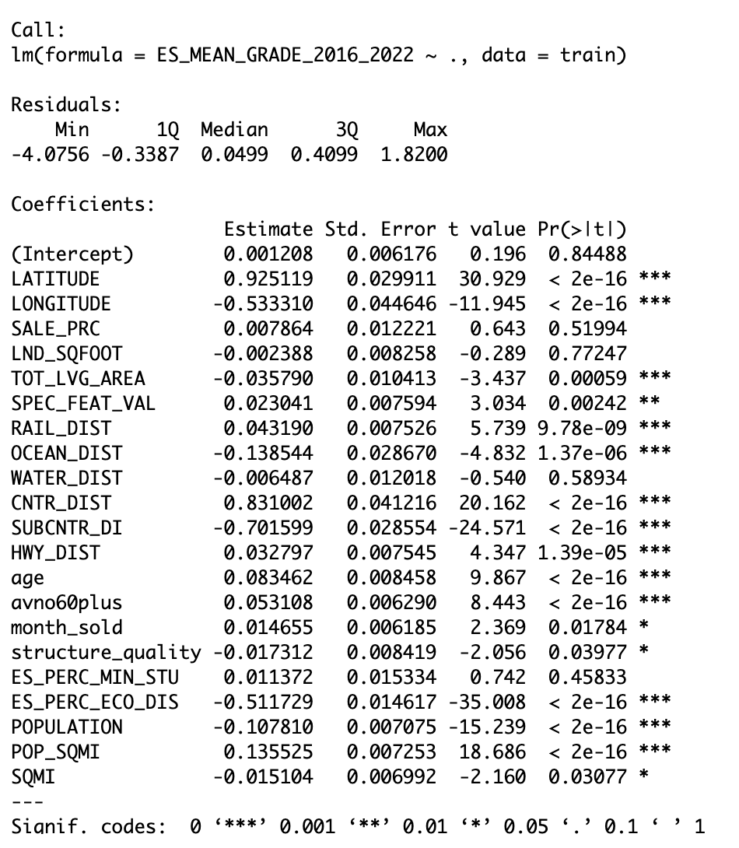
Multiple Linear Regression
Mean grade was fit against 20 predictors
Sale price was not a significant predictor of mean grade
Latitude, longitude, distance to the nearest railway, ocean, business district, nearest subcenter (metrorail), nearest highway, and population per square mile are notable significant predictors

Slide 57
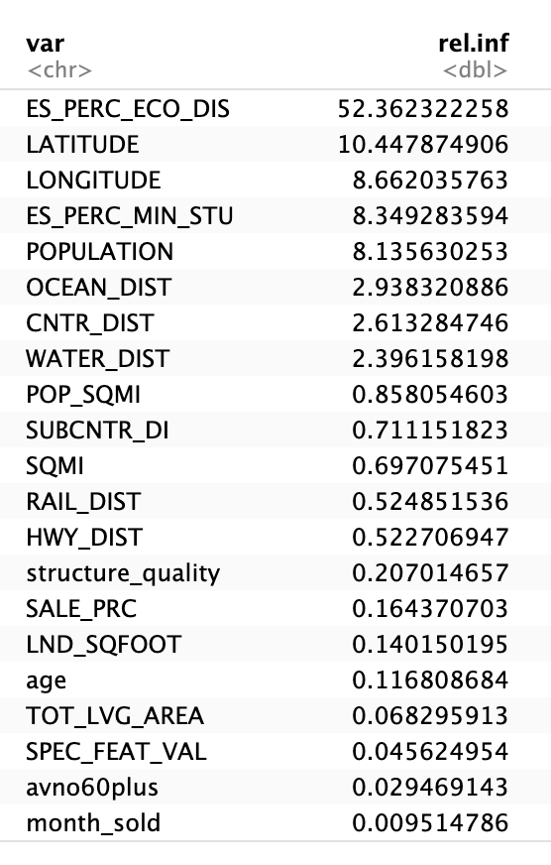
Boosting
Boosting was used to look at the most influential variables in the model for predicting mean grade with a non-linear model
The most important variable in determining mean grade was the percentage of economically disadvantaged students by a huge margin
Also important were latitude and longitude, and percentage of minority students and total population of the census tract that the home is within
Much less important but still non-zero were distance to the ocean, distance to the business district, and distance to the nearest body of water

Slide 58
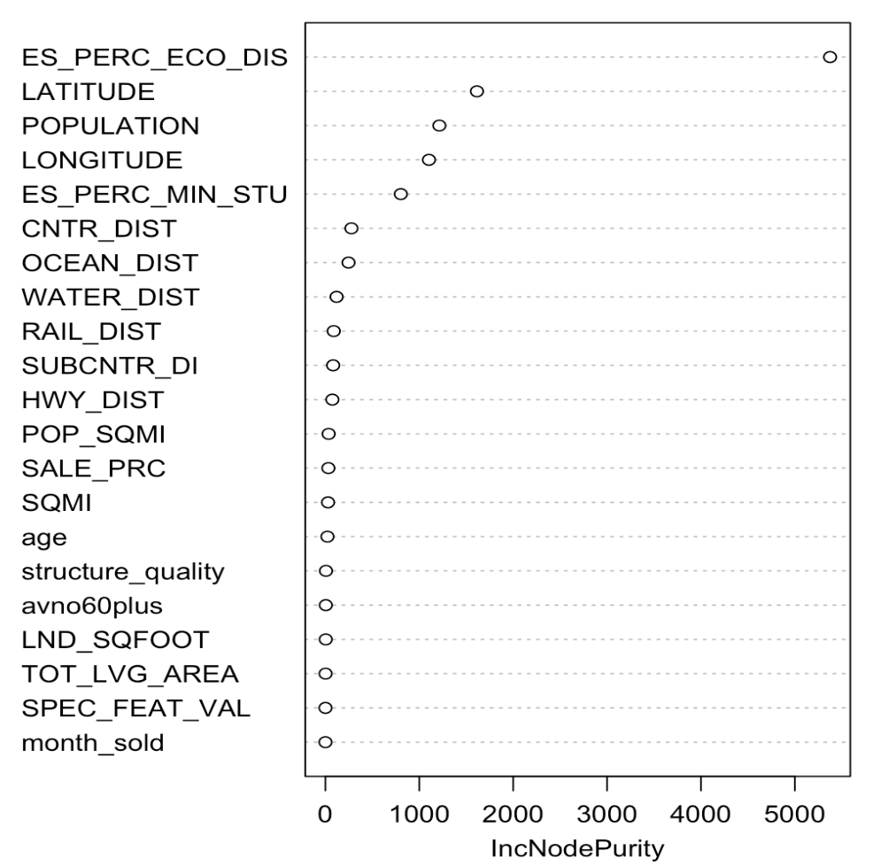
Bagging
We see similar results when comparing the bagging and random forest models and looking at the increase in node purity (a measure of the importance of a variable)
Sale price is not an important variable in predicting mean grade in both bagging and boosting models

Slide 59
Conclusions
Can home sale price be used to predict school performance? Not with this dataset or the methods used.
Is there a relationship between school performance and any of the predictor variables of home sale price? YES
Are there spatial relationships for school performance measures and for home sale prices? YES
Are there spatial relationships between high-performing schools and high-income/high sale price properties? YES
Are there outliers of high-performing schools in areas with low home sale prices, and vice-versa? YES
Are there other relationships observed between variables included in either dataset that include a spatial component? YES

Slide 60
Limitations
Only elementary school performance data was used
The sample size of the houses sold in Miami is large, but still only captures a limited proportion of the population of school-aged children in Miami
The homes used in the data set were not uniformly distributed, so home sale price may not be captured well in some school districts
The sale prices were only from 2016, and there may be external factors that affect home prices and/or school performance depending on the year (COVID, housing market crash, etc.)
The only measure of school performance used was the mean grade that the school received from 2016-2020
The sample was limited to Miami-Dade county, which presents unique demographics when compared to the average American city and population

Slide 61
Future Work
Future work could improve upon this project by addressing the previously listed limitations.
Most importantly, a much larger sample size for the home sale prices that captures a representative sample would be needed to more accurately capture any trends between sale price and school performance
More measures of school performance may also demonstrate trends not seen by only looking at the mean grade of the school (such as reading/math achievement scores)

